Slide 1
Future EC Prediction
Muhammad Ali
MS Biology
NYU Downtown

Slide 2

Goals for this Project
Compiling accurate metadata (identified 1,384 samples)
Predict EC (diagnosis) from Infinium HM450/850 – (450k – 850k CpGs, respectively)
Predict Future EC from Infinium HM450/850 (survival analysis)
Identify CpGs associated with EC prediction – functional analysis
Create an EpiScore
Correlate with (single-cell)transcriptomics, proteomics, and genome organization (ATAC/Hi-C)
✅
✅
⏳
✅
❌
❌

Slide 3
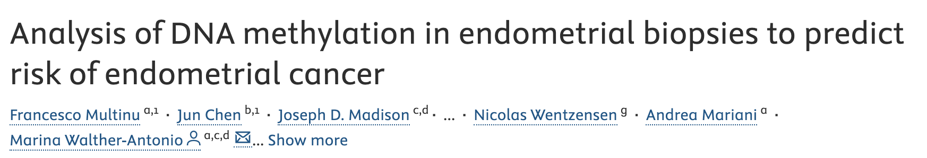

Recap
Methylation at the genes they identified doesn’t work.
2 genes: HAND2 and ADCYAP1.
Notes:
“A linear regression model with an interaction term was used to test for the effect of biopsy histology on gene methylation and its interaction with the future diagnosis of EC.”

Slide 4
Recap
Cleaned up the data
Built the following (bootstrapped) models:
Penalized Cox proportional hazards model
Random Survival Forests
Random Forest Classifiers
Penalized Logistic Regression
Differential expression analysis ( ~ Death * Overall Survival)
Feature engineering using weighted sums of CpGs x genes
Methylation and RNA-seq based psuedotime analysis
Projecting the total methylation along with psuedotime

Slide 5
Goal 1: Metadata

Slide 6



Data Cleaning Steps
TCGAbiolinks
GEOquery
Metadata & β values
IDATs & Metadata
sesame
Clean-up metadata;
Grouped by “case_submitter_id”
Generating β values
Grueling metadata clean-up
Column names changed to match “case_submitter_id”
Matrix columns renamed to GEO Sample Accession (GSM)
Combined, Cleaned Metadata – the holy grail

Slide 7
Accession | Number of Samples | Type of Data | Number of Probes | Tissue
GSE136791 | 103 | DNAm EPIC | 850,000 | Endometrial tumor
GSE138072 | 32 | DNAm EPIC | 850,000 | MSC Cancer and Non-cancer
GSE155311 | 33 | DNAm EPIC | 850,000 | STIC/HGSC and adjacent normal fallopian tube (same patient)
GSE155760 | 96 | DNAm EPIC | 850,000 | HGSOC, non-HGSOC malignant, and controls
GSE178610 | 80 | DNAm EPIC | 850,000 | Patients with EEC
GSE243303 | 91 | DNAm EPIC | 850,000 | Precursor lesions of EEC
GSE263434 | 283 | DNAm EPIC, RNA-seq, CNV | 850,000, 37,000 genes | HGSC or HGEC
GSE67116 | 96 | DNAm HM450 | 450,000 | Hyperplasia and EC
GSE89093 | 92 | DNAm HM450 | 450,000 | Monozygotic twins (1 cancer and 1 healthy)
GSE90060 | 34 | DNAm HM450 | 450,000 | Different time points in the menstrual cycle of healthy women
TCGA-UCEC | 444 | DNAm HM450, RNA-seq, CNV | 450,000, ~30,000 genes | Endometrial tumors
Total | 1,384 (1260 cancer - 124 healthy) |  | DNAm (1,384) + RNA-seq (727) + CNV (727) | -
Feature engineering/
Diagnosis
Future EC
Validation set

Slide 8
Goal 2: Diagnosing EC

Slide 9

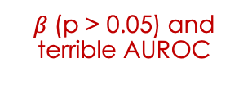
Analysis (Diagnosis Prediction)
Diagnosis Prediction
ADCYAP1 & HAND2 and probes associated with these genes
Logistic regression using mean methylation of genes
Bootstrapped Penalized logistic regression using probes associated with these genes
Random forest based Classifier
Maybe a self-supervised Loss function might help in identifying new patterns
Non-zero CpGs
Mean-importance filtering
$β$(p > 0.05) and terrible AUROC
Logistic regression using identified features
Ensemble Method for Feature Selection
$β$(p > 0.05)

Slide 10
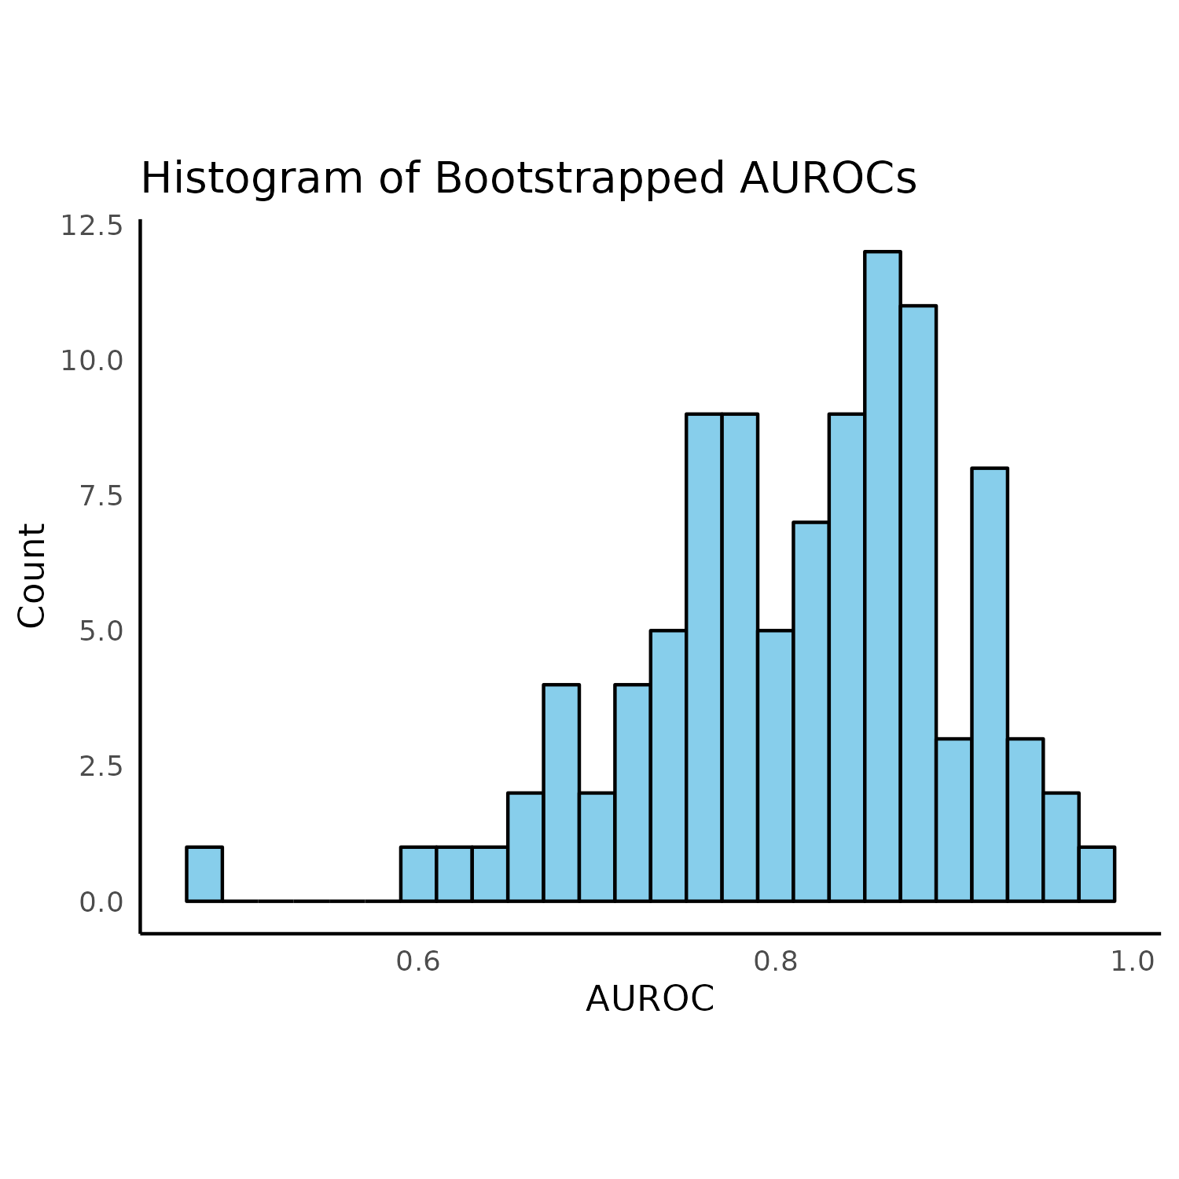
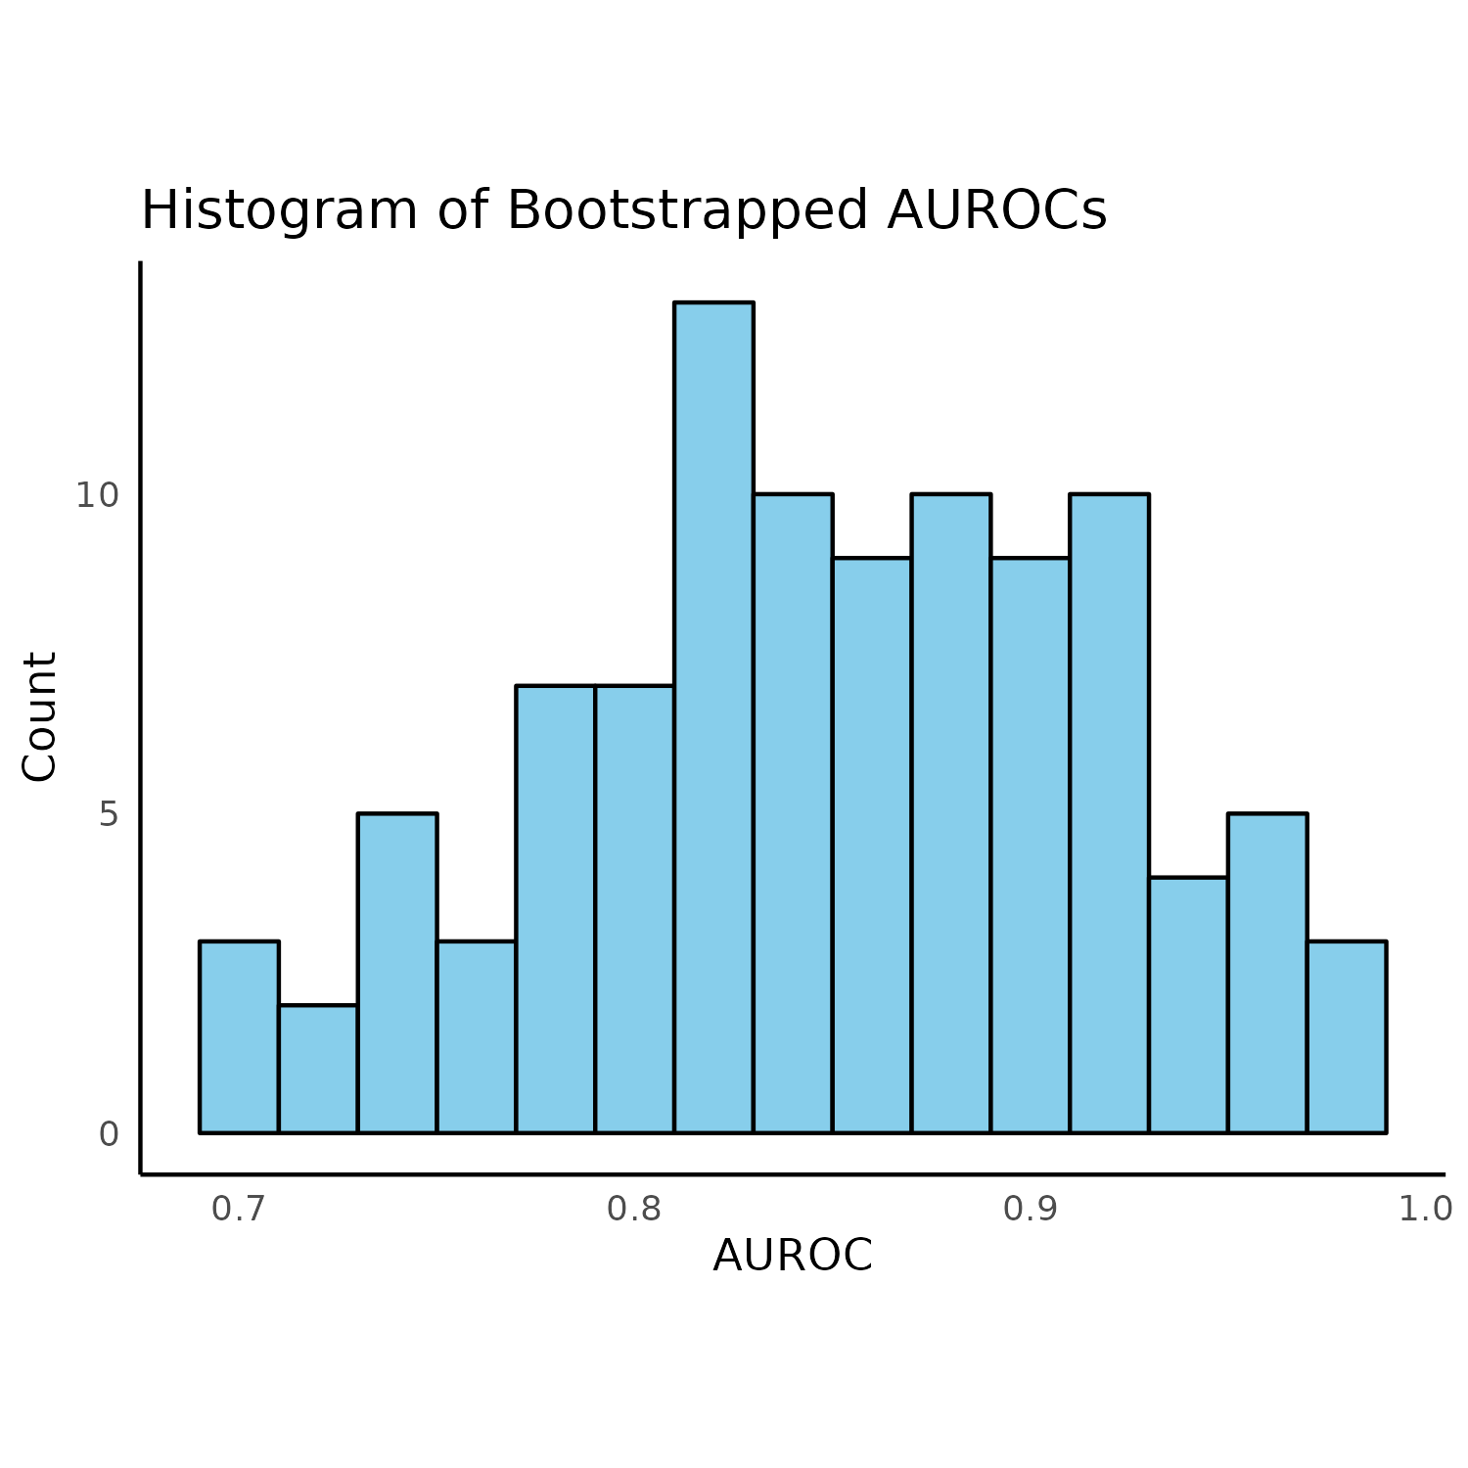
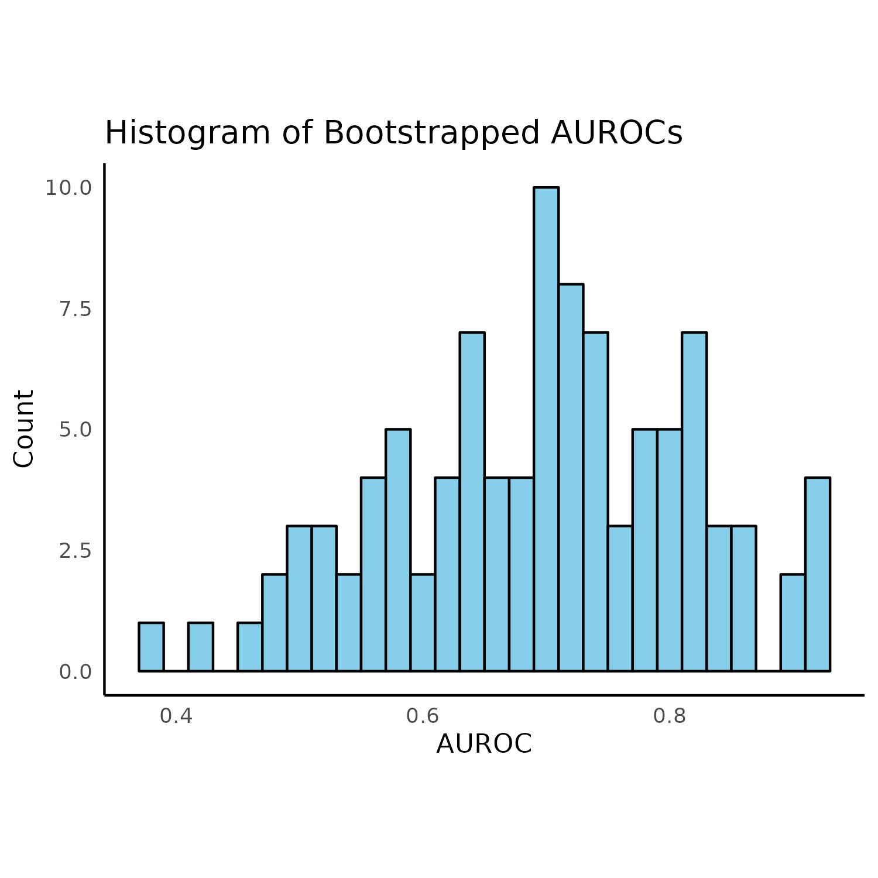
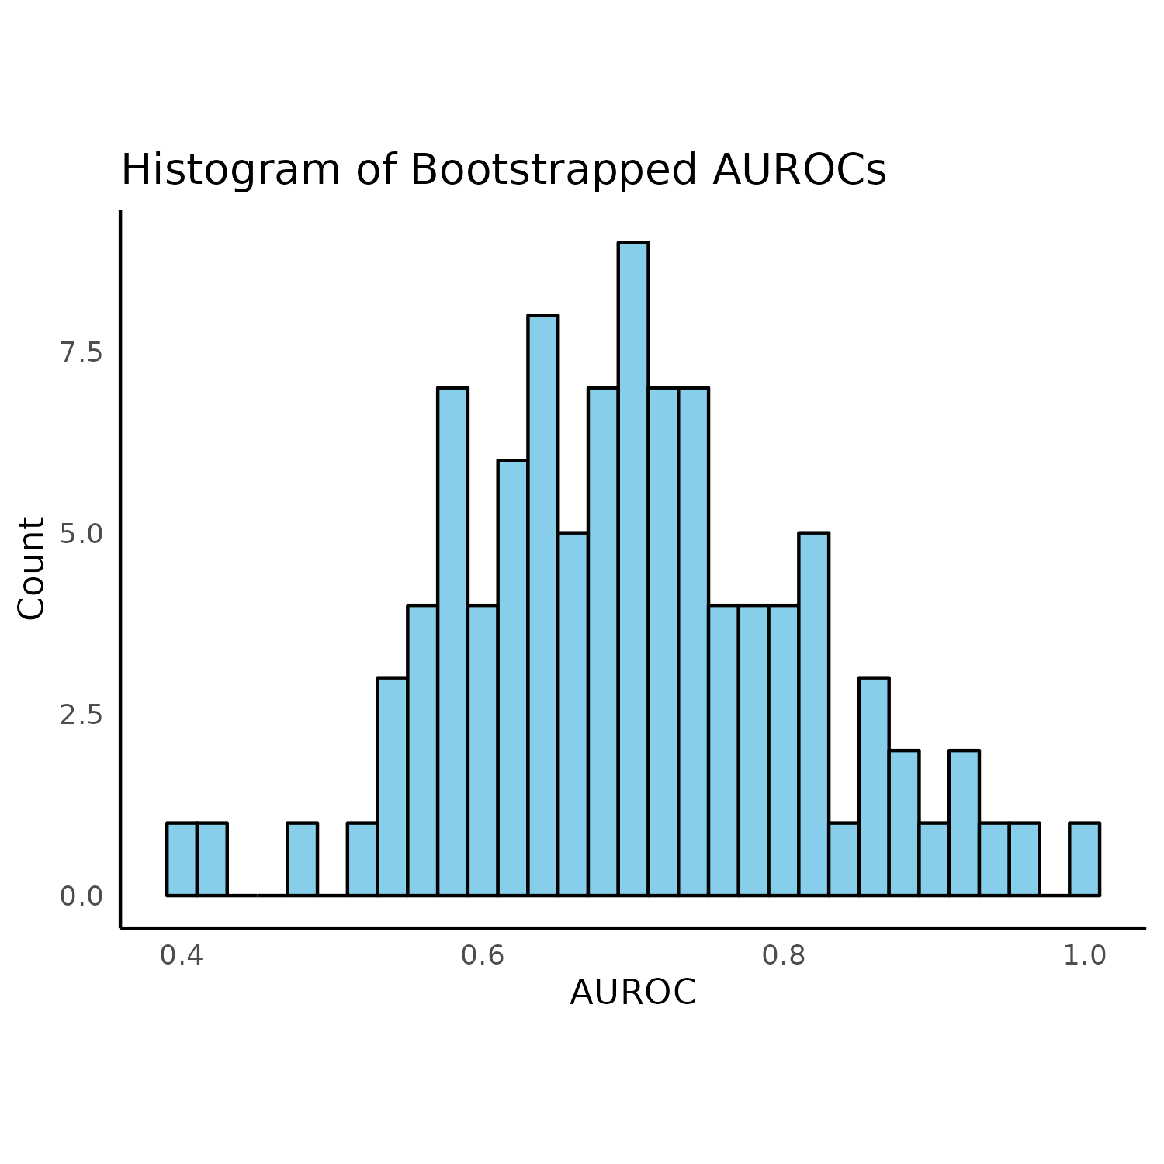
Diagnosis EC using ADCYAP1 and HAND2
Dataset: GSE89093
Monozygotic twins
One healthy | One EC
Reported AUC:
ADCYAP1 (AUC: 0.71)
HAND2 (AUC: 0.83)
Mean AUC I calculated:
ADCYAP1 EN (AUC: 0.69)
HAND2 EN (AUC: 0.70)
ADCYAP1 RF (AUC: 0.85)
HAND2 RF (AUC: 0.81)
Both together RF (AUC: 0.81)
Based on all CpGs labeled for that gene
100 bootstraps | Elastic-net | 5000 trees
RF
EN
ADCYAP1
HAND2

Slide 11
Goal 3: Predicting Future EC

Slide 12

Analysis (Survival Prediction)
Survival Prediction
New analysis
Penalized cox proportional hazards model using all probes
Random survival forests using CpGs from ADCYAP1 and HAND2
Psuedotime analysis using methylation
Calculated PhenoAge to see if it can predict Future EC
Shows different methylation profiles for serous and endometrial adenocarcinomas
Takes very long and returns like 6 CpGs
Ambiguous results, at best.

Slide 13
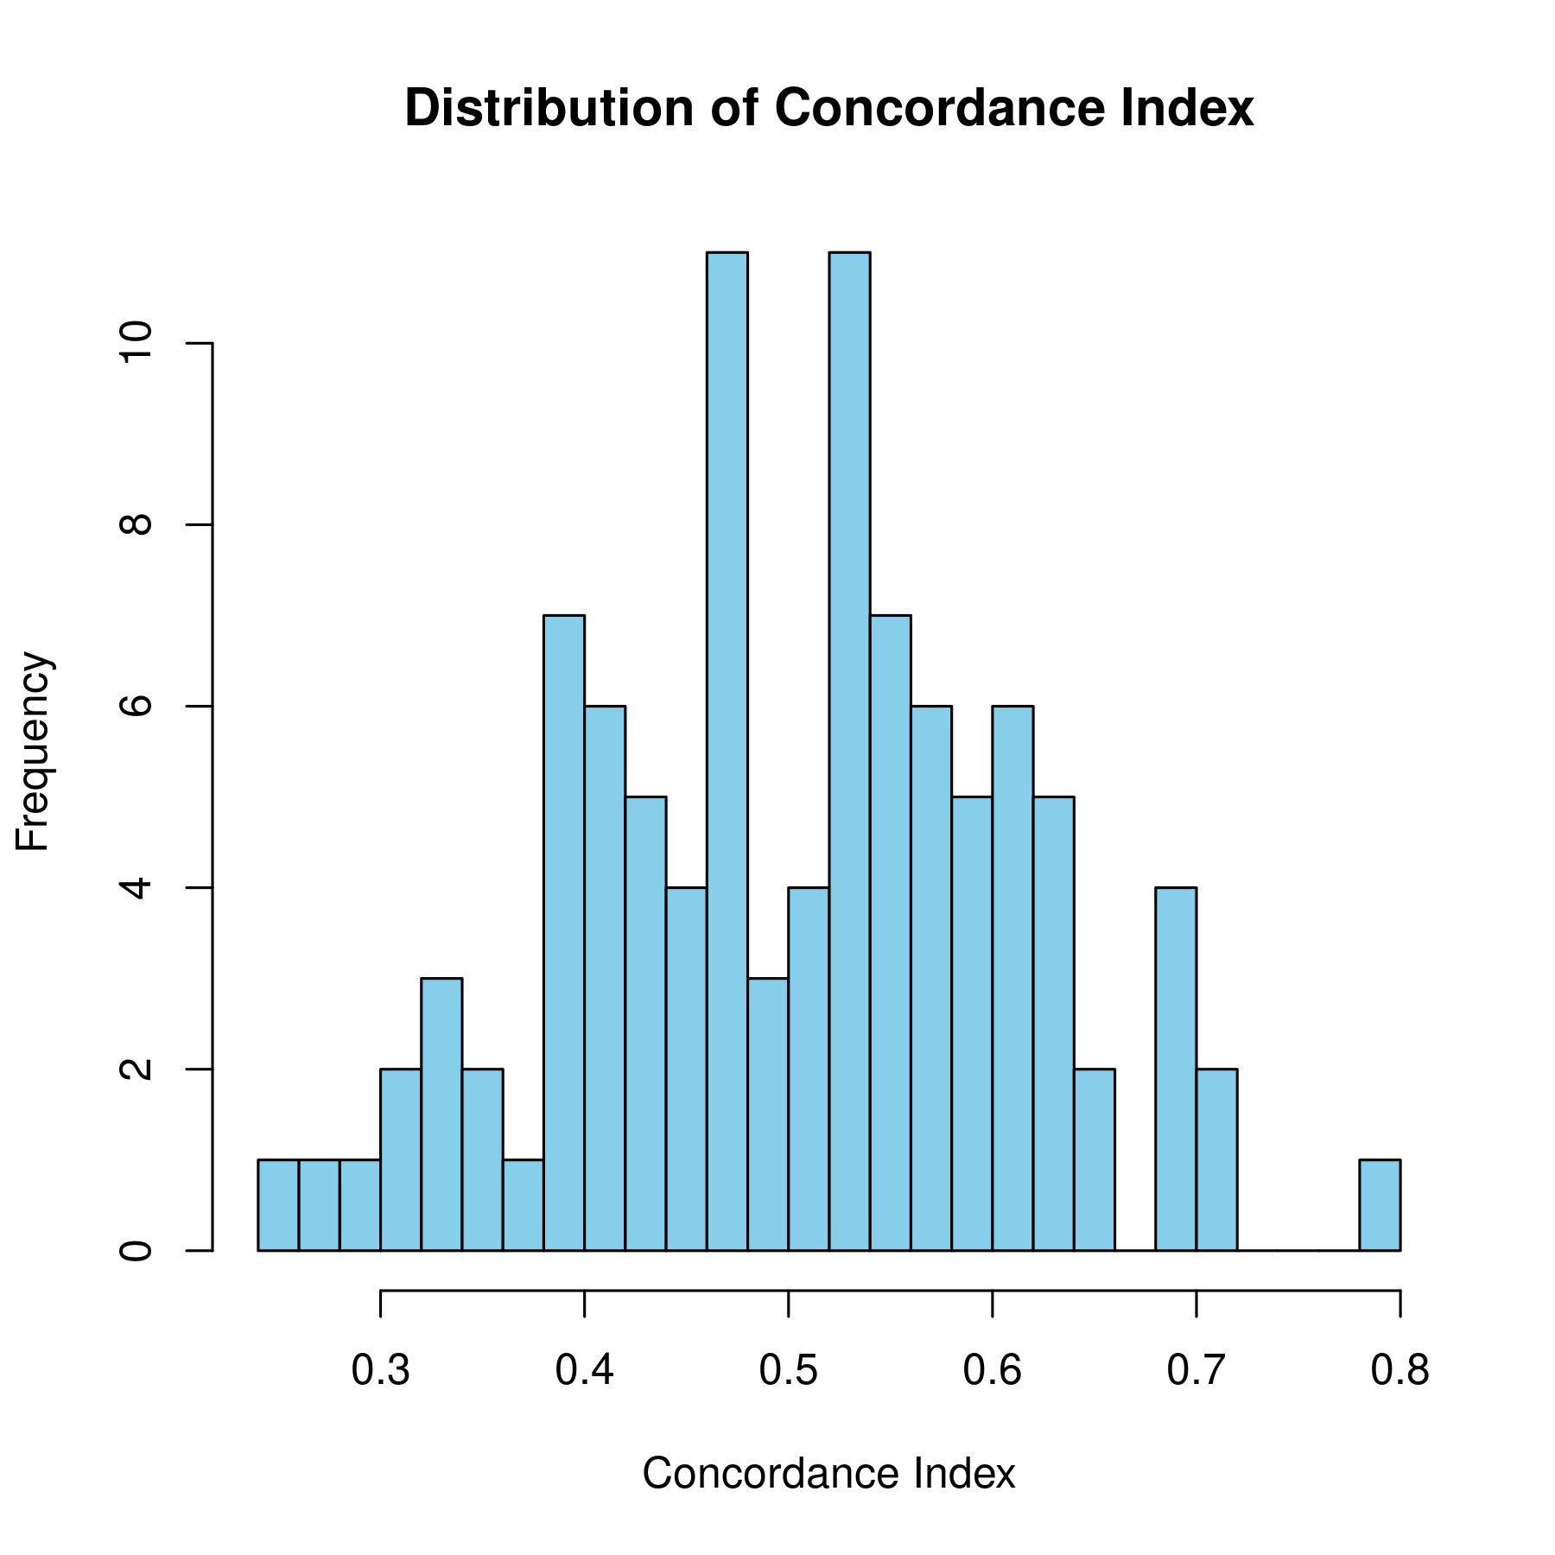
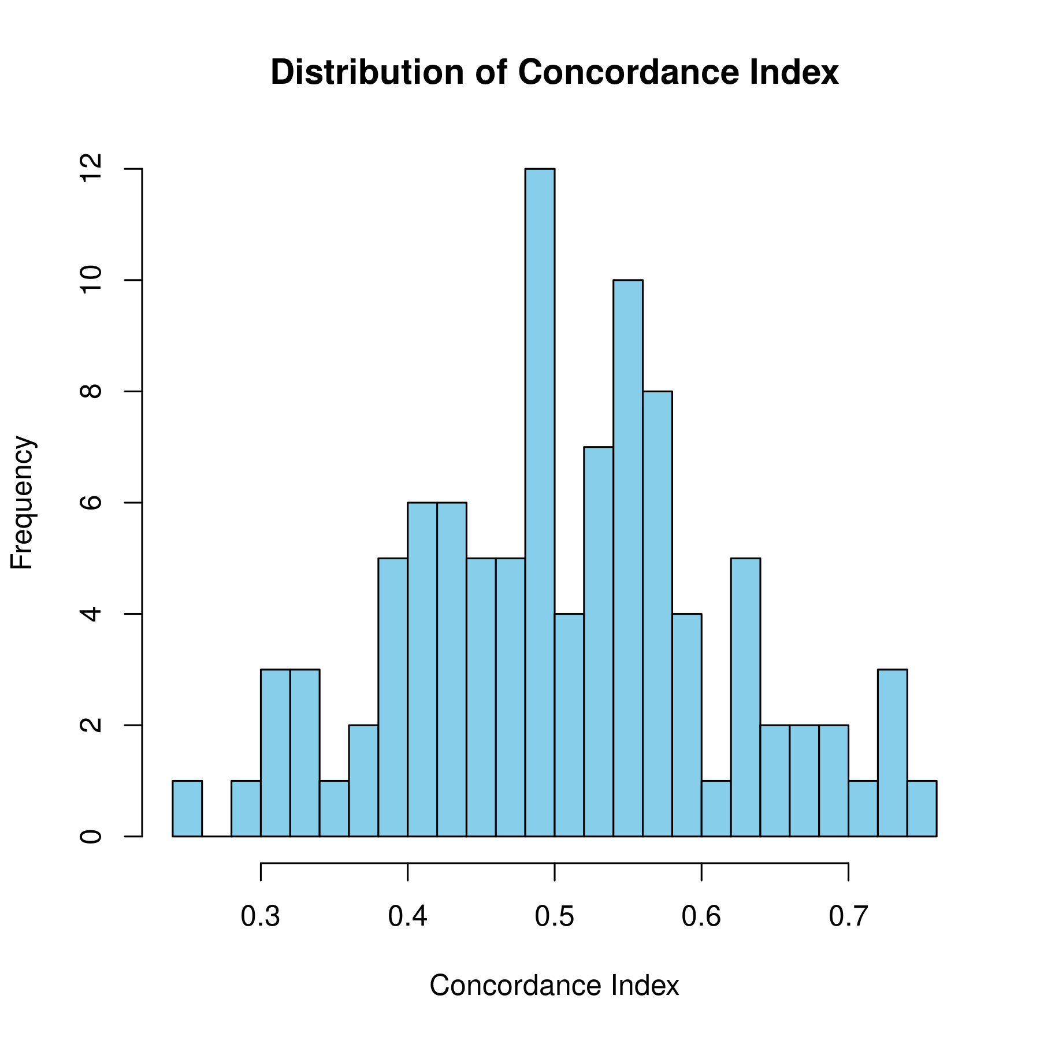
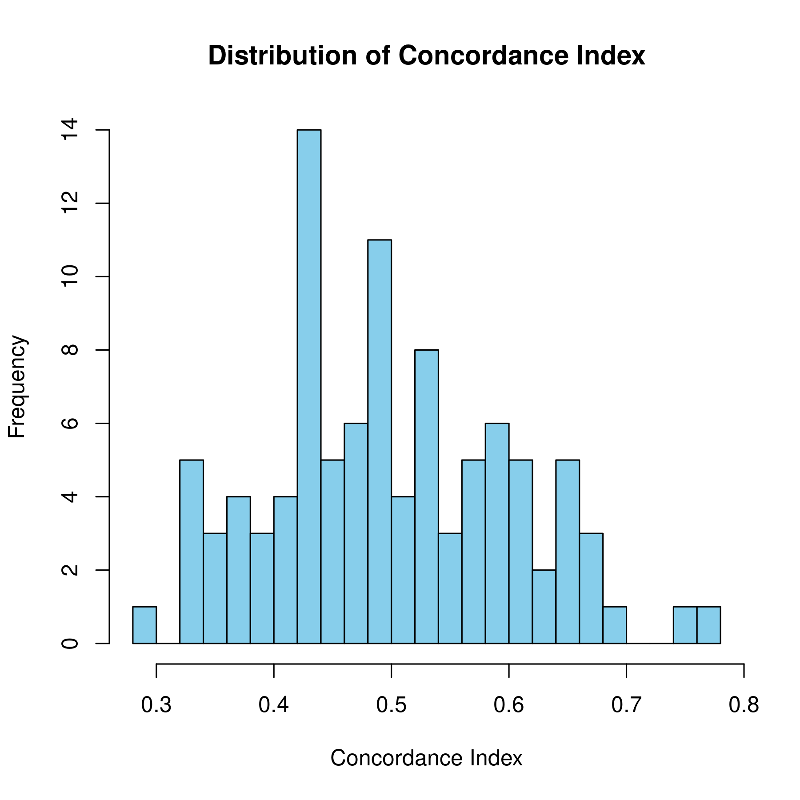
Survival Analysis (Recap)
ADCYAP1 RSF
HAND2
RSF
ADCYAP1 + HAND2 RSF

Slide 14
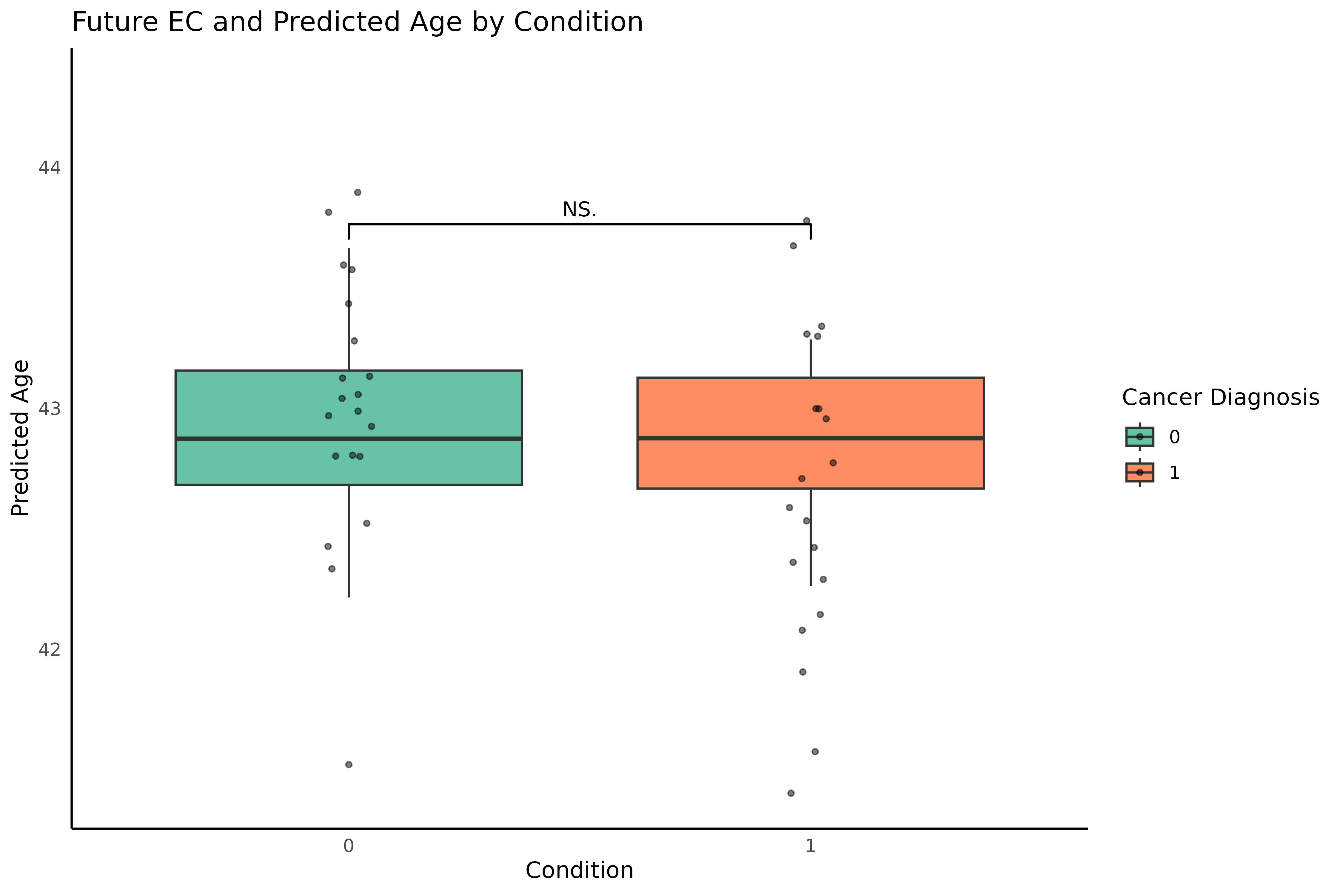
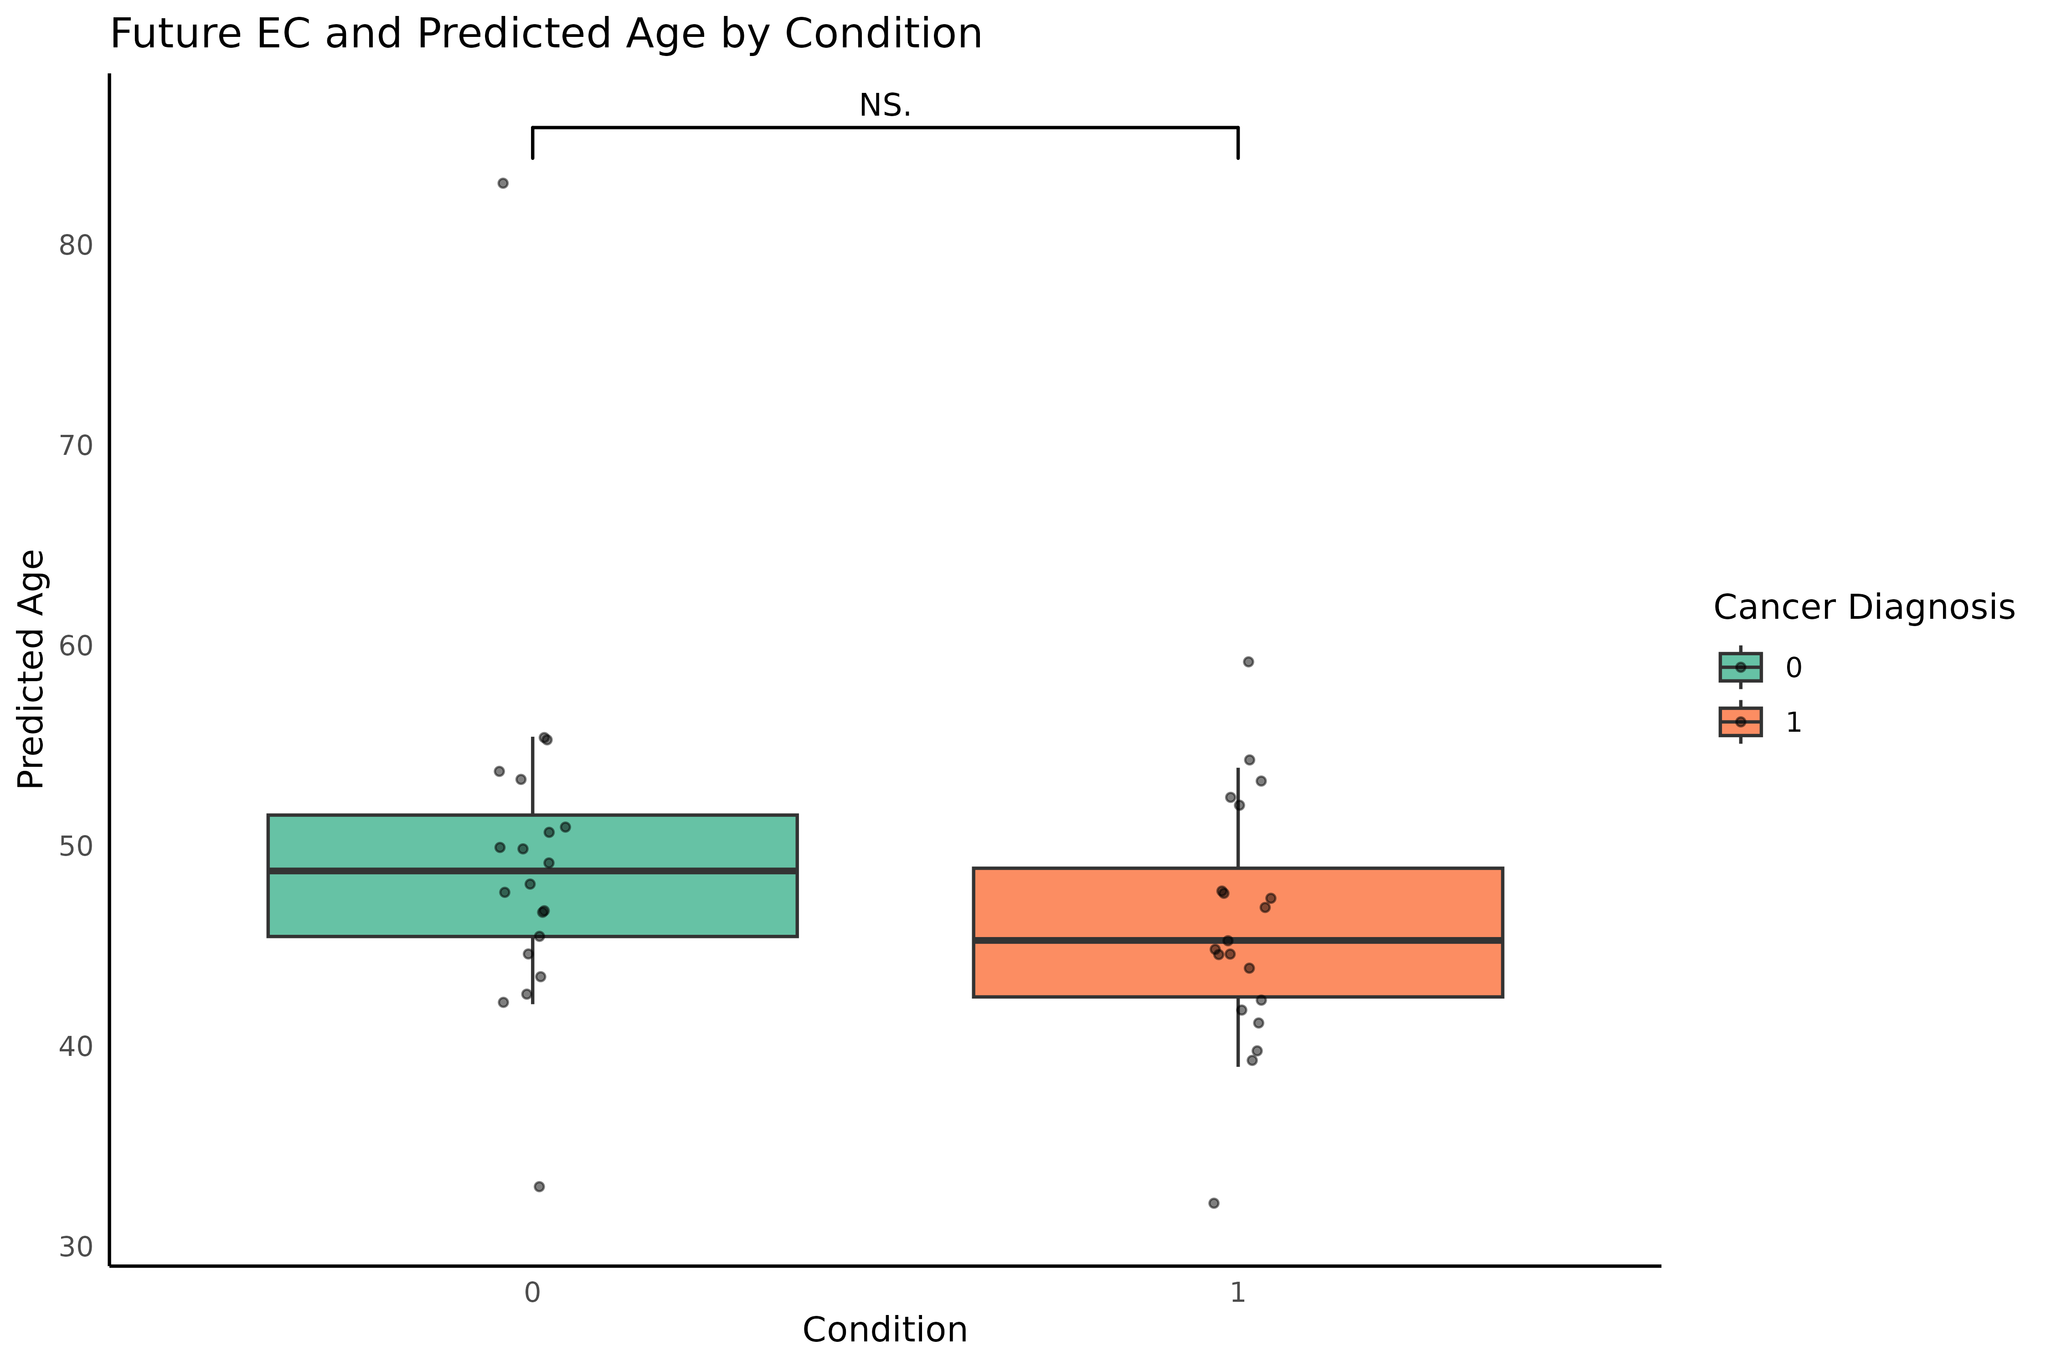
Epigenetic Age and Future Cancer
HorvathAge
PhenoAge

Slide 15
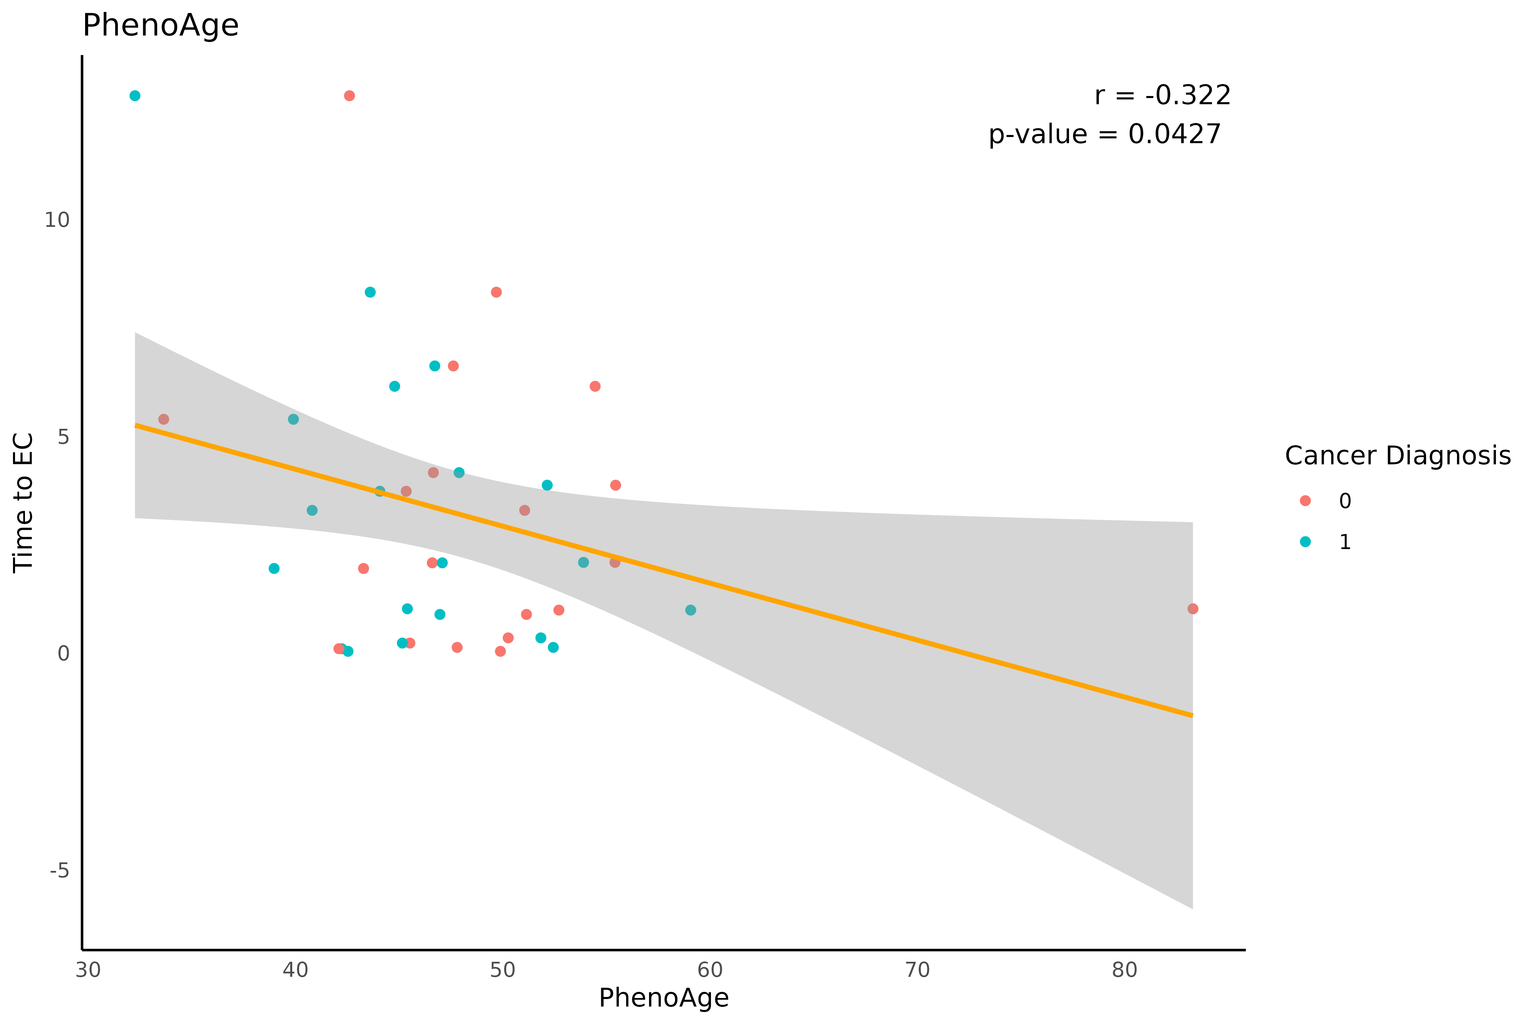
PhenoAge correlates with Future EC
Dataset: GSE89093
Monozygotic twins
One healthy | One EC
Future EC data N = 40
512 CpGs
146 significantly correlated with Future EC

Slide 16
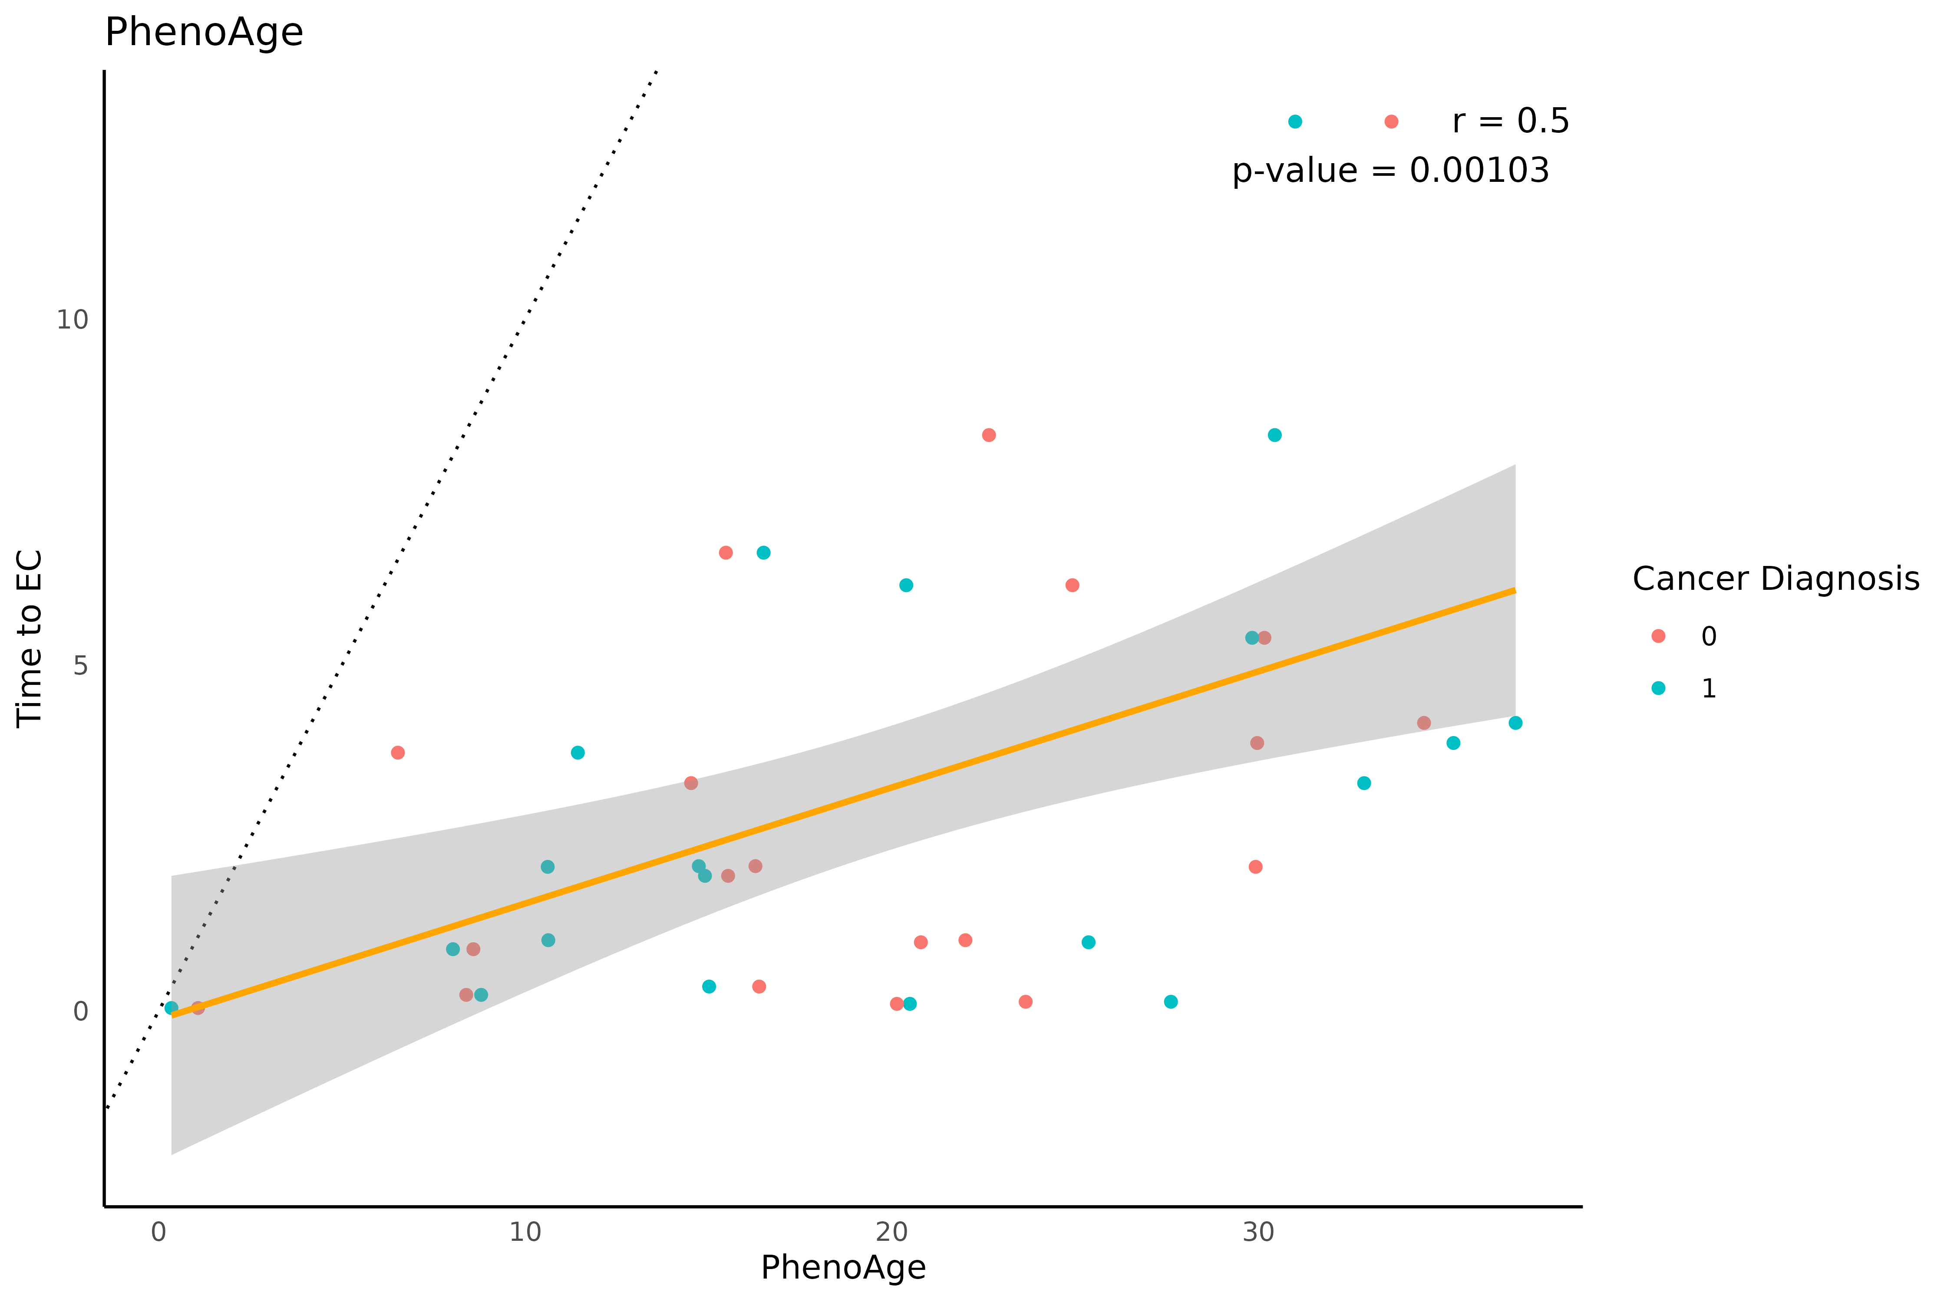
PhenoAge correlates with Future EC
Dataset: GSE89093
Monozygotic twins
One healthy | One EC
Future EC data N = 40
512 CpGs
146 significantly correlated with Future EC

Slide 17
Analysis (Survival Prediction)
Dataset: GSE89093
Monozygotic twins
One healthy | One EC
Future EC data N = 40
Tissue: Peripheral blood
PhenoAge CpGs (512)
Penalized cox proportional hazards model using all probes
Significant correlation (146 probes)
Penalized cox proportional hazards model using all probes
Predict survival WITH train:test split
Difference NOT statistically siginficant
Predict survival WITH train:test split
Selects 9 probes
Predict survival WITHOUT train:test split
Statistically significant difference
Predict survival WITHOUT train:test split
Selects 15 probes

Slide 18
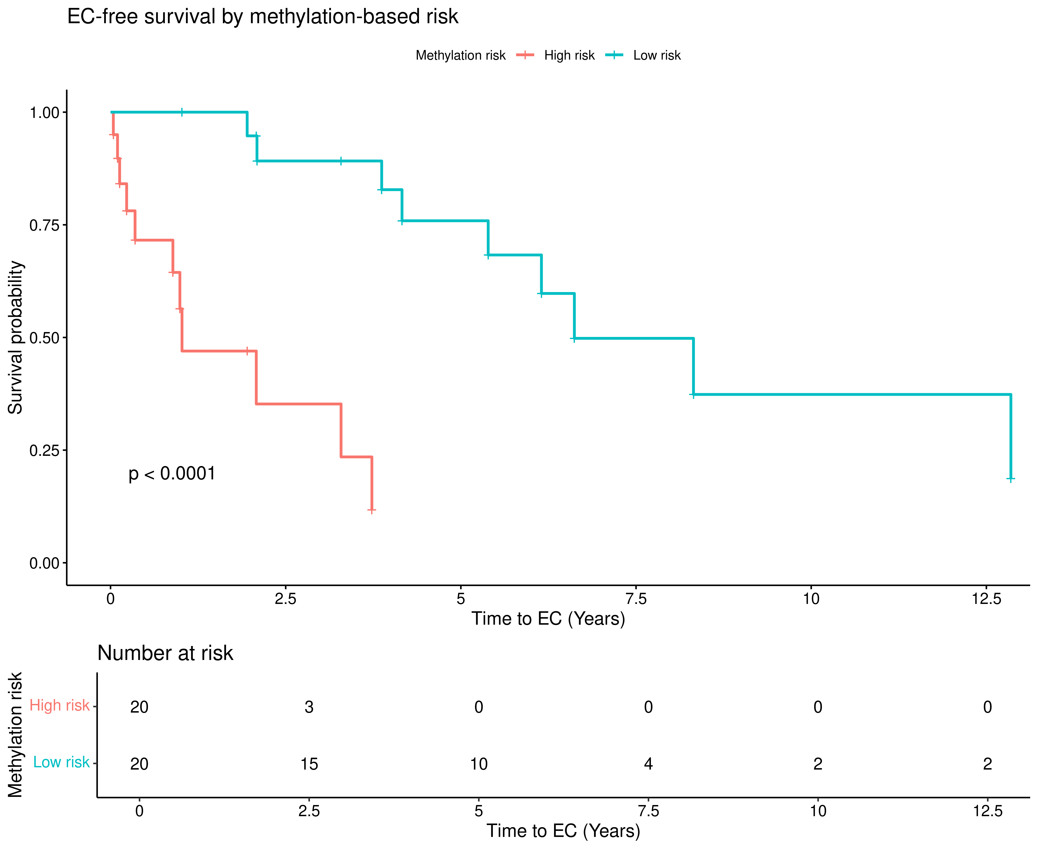
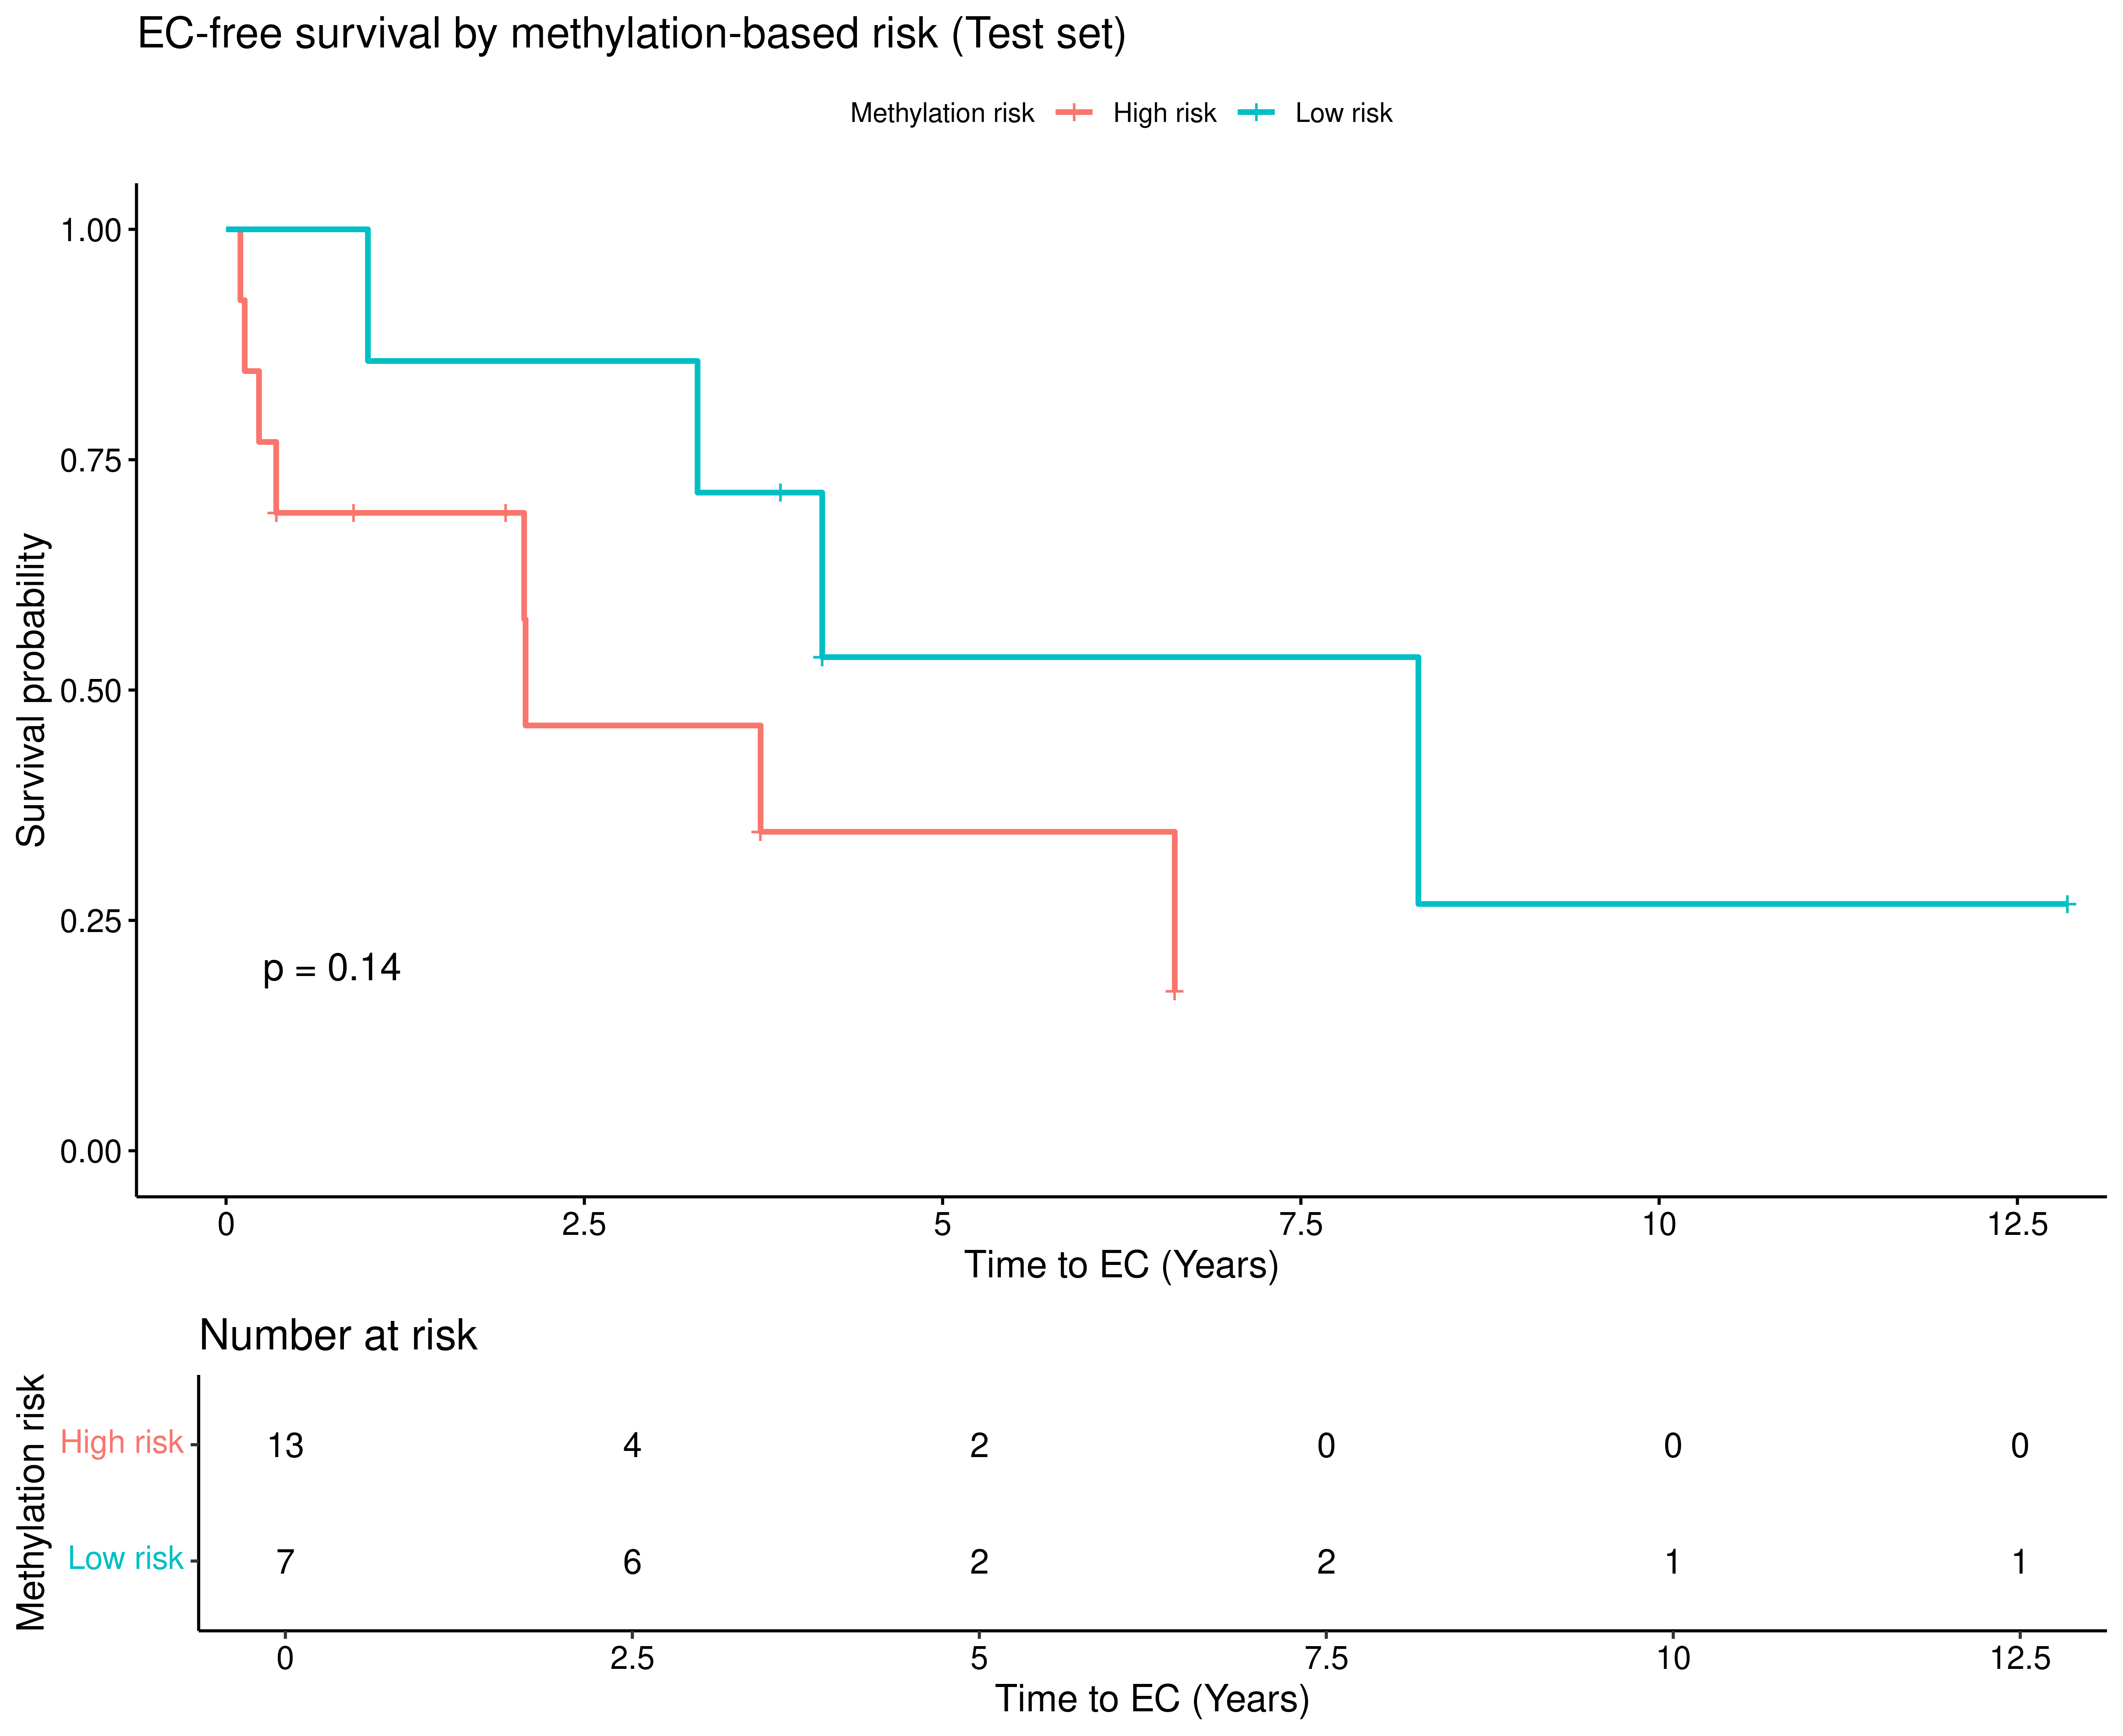
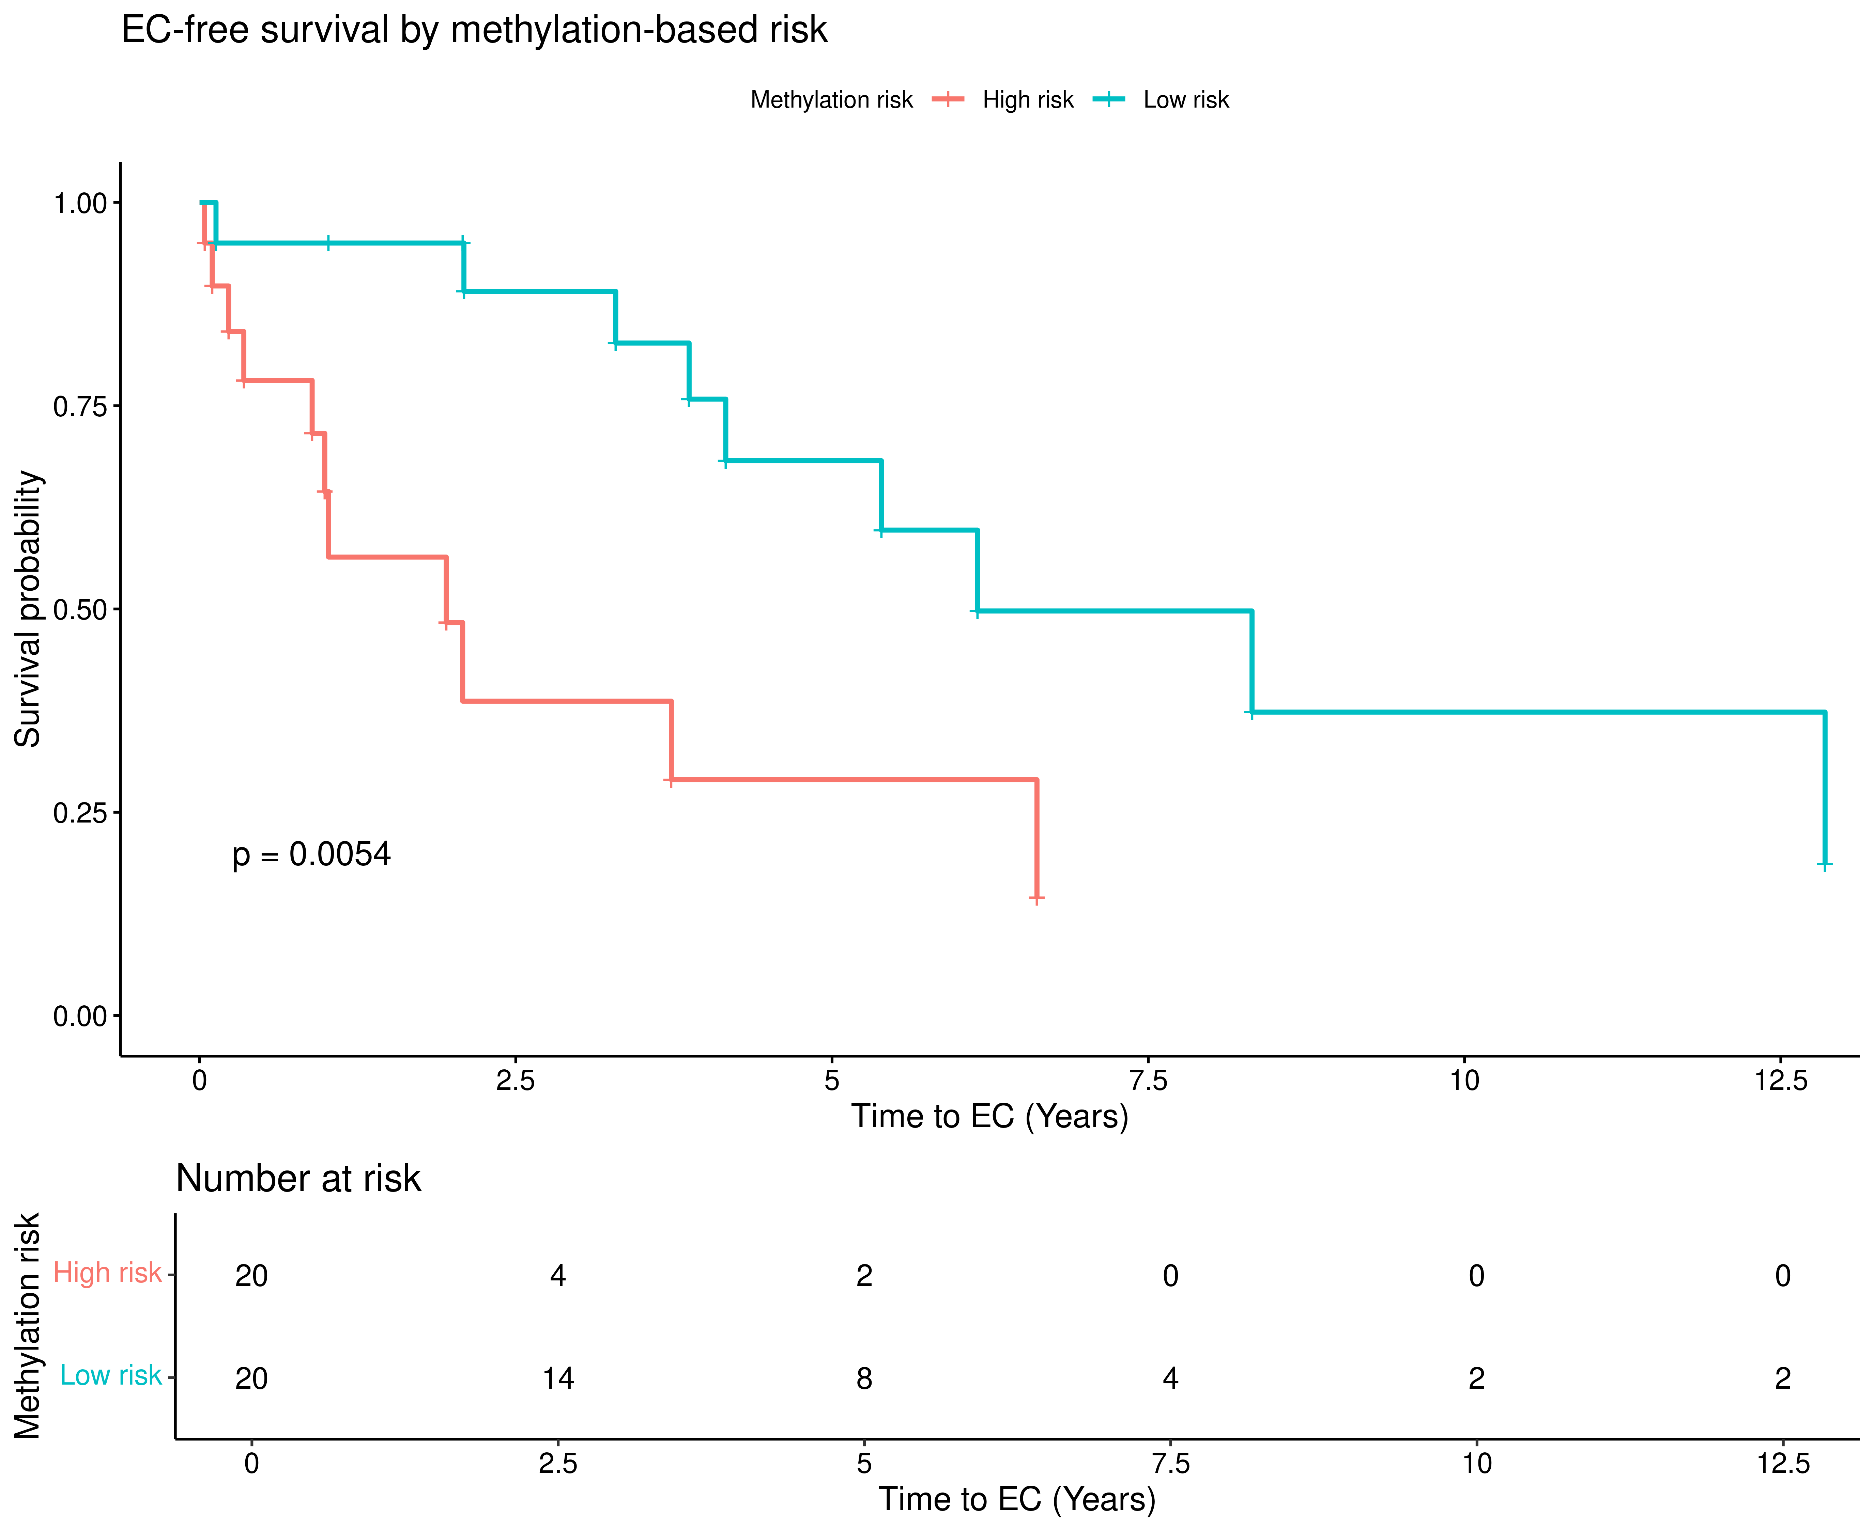
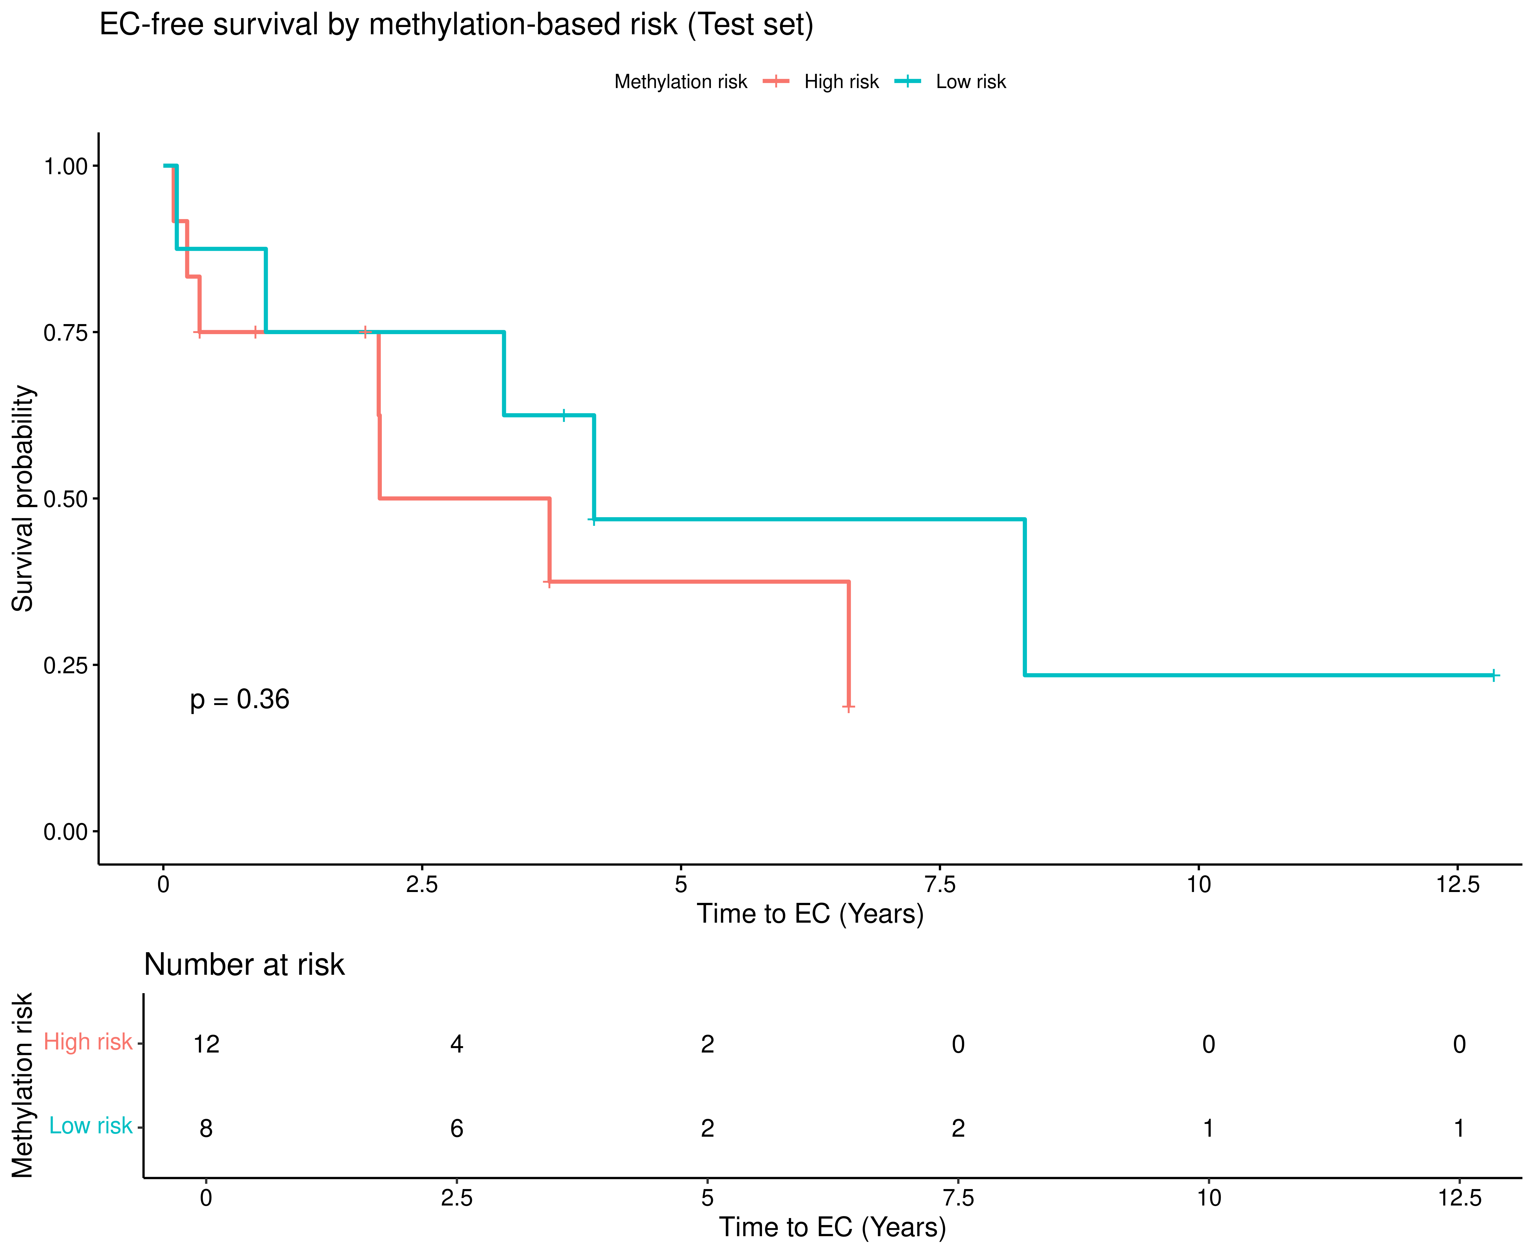
15 selected CpGs (146 significant only)
9 selected CpGs (512 all PhenoAge)
NO train:test split
Train:test split

Slide 19
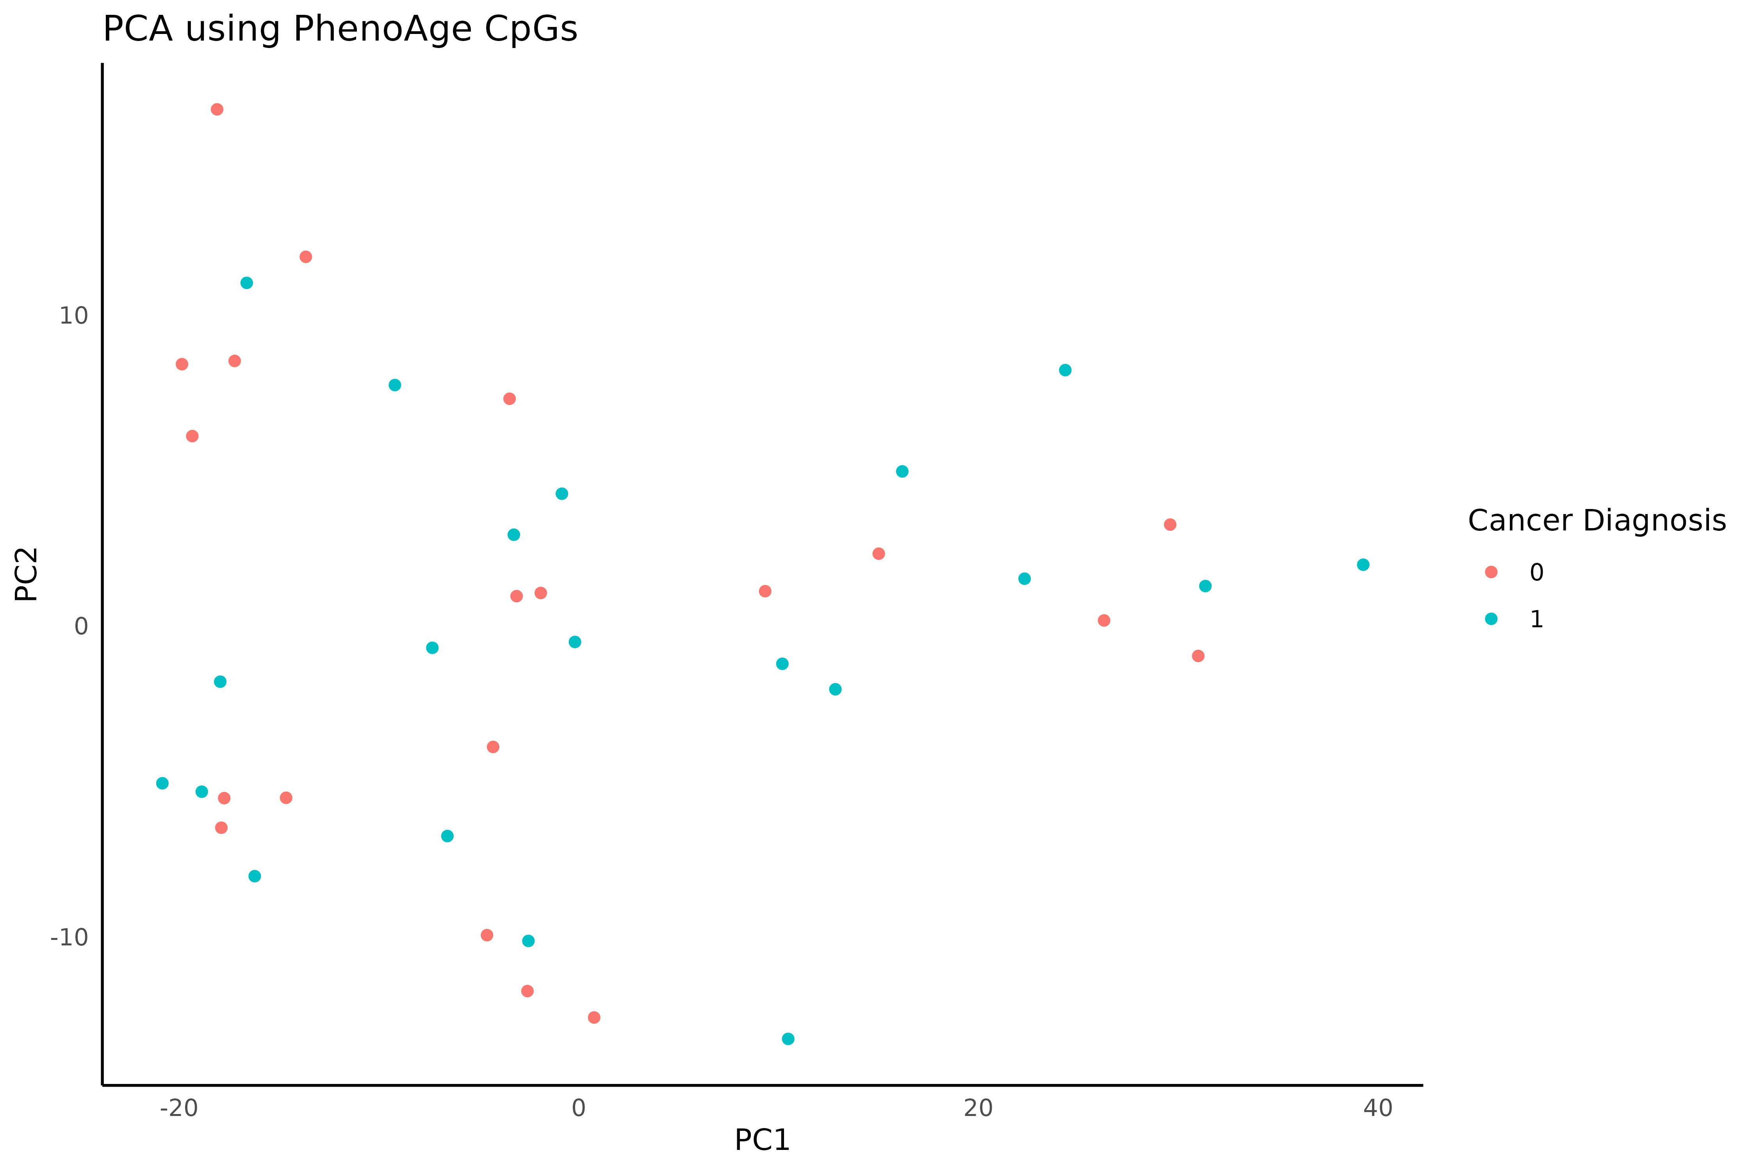
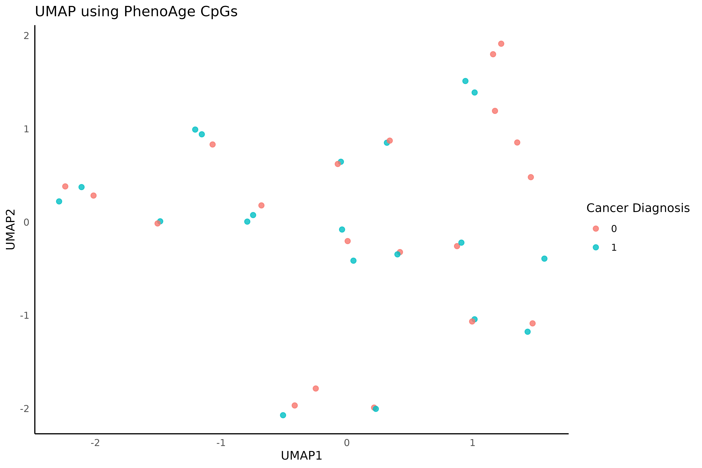
Unable to Cluster Samples using PhenoAge CpGs
PCA
UMAP

Slide 20
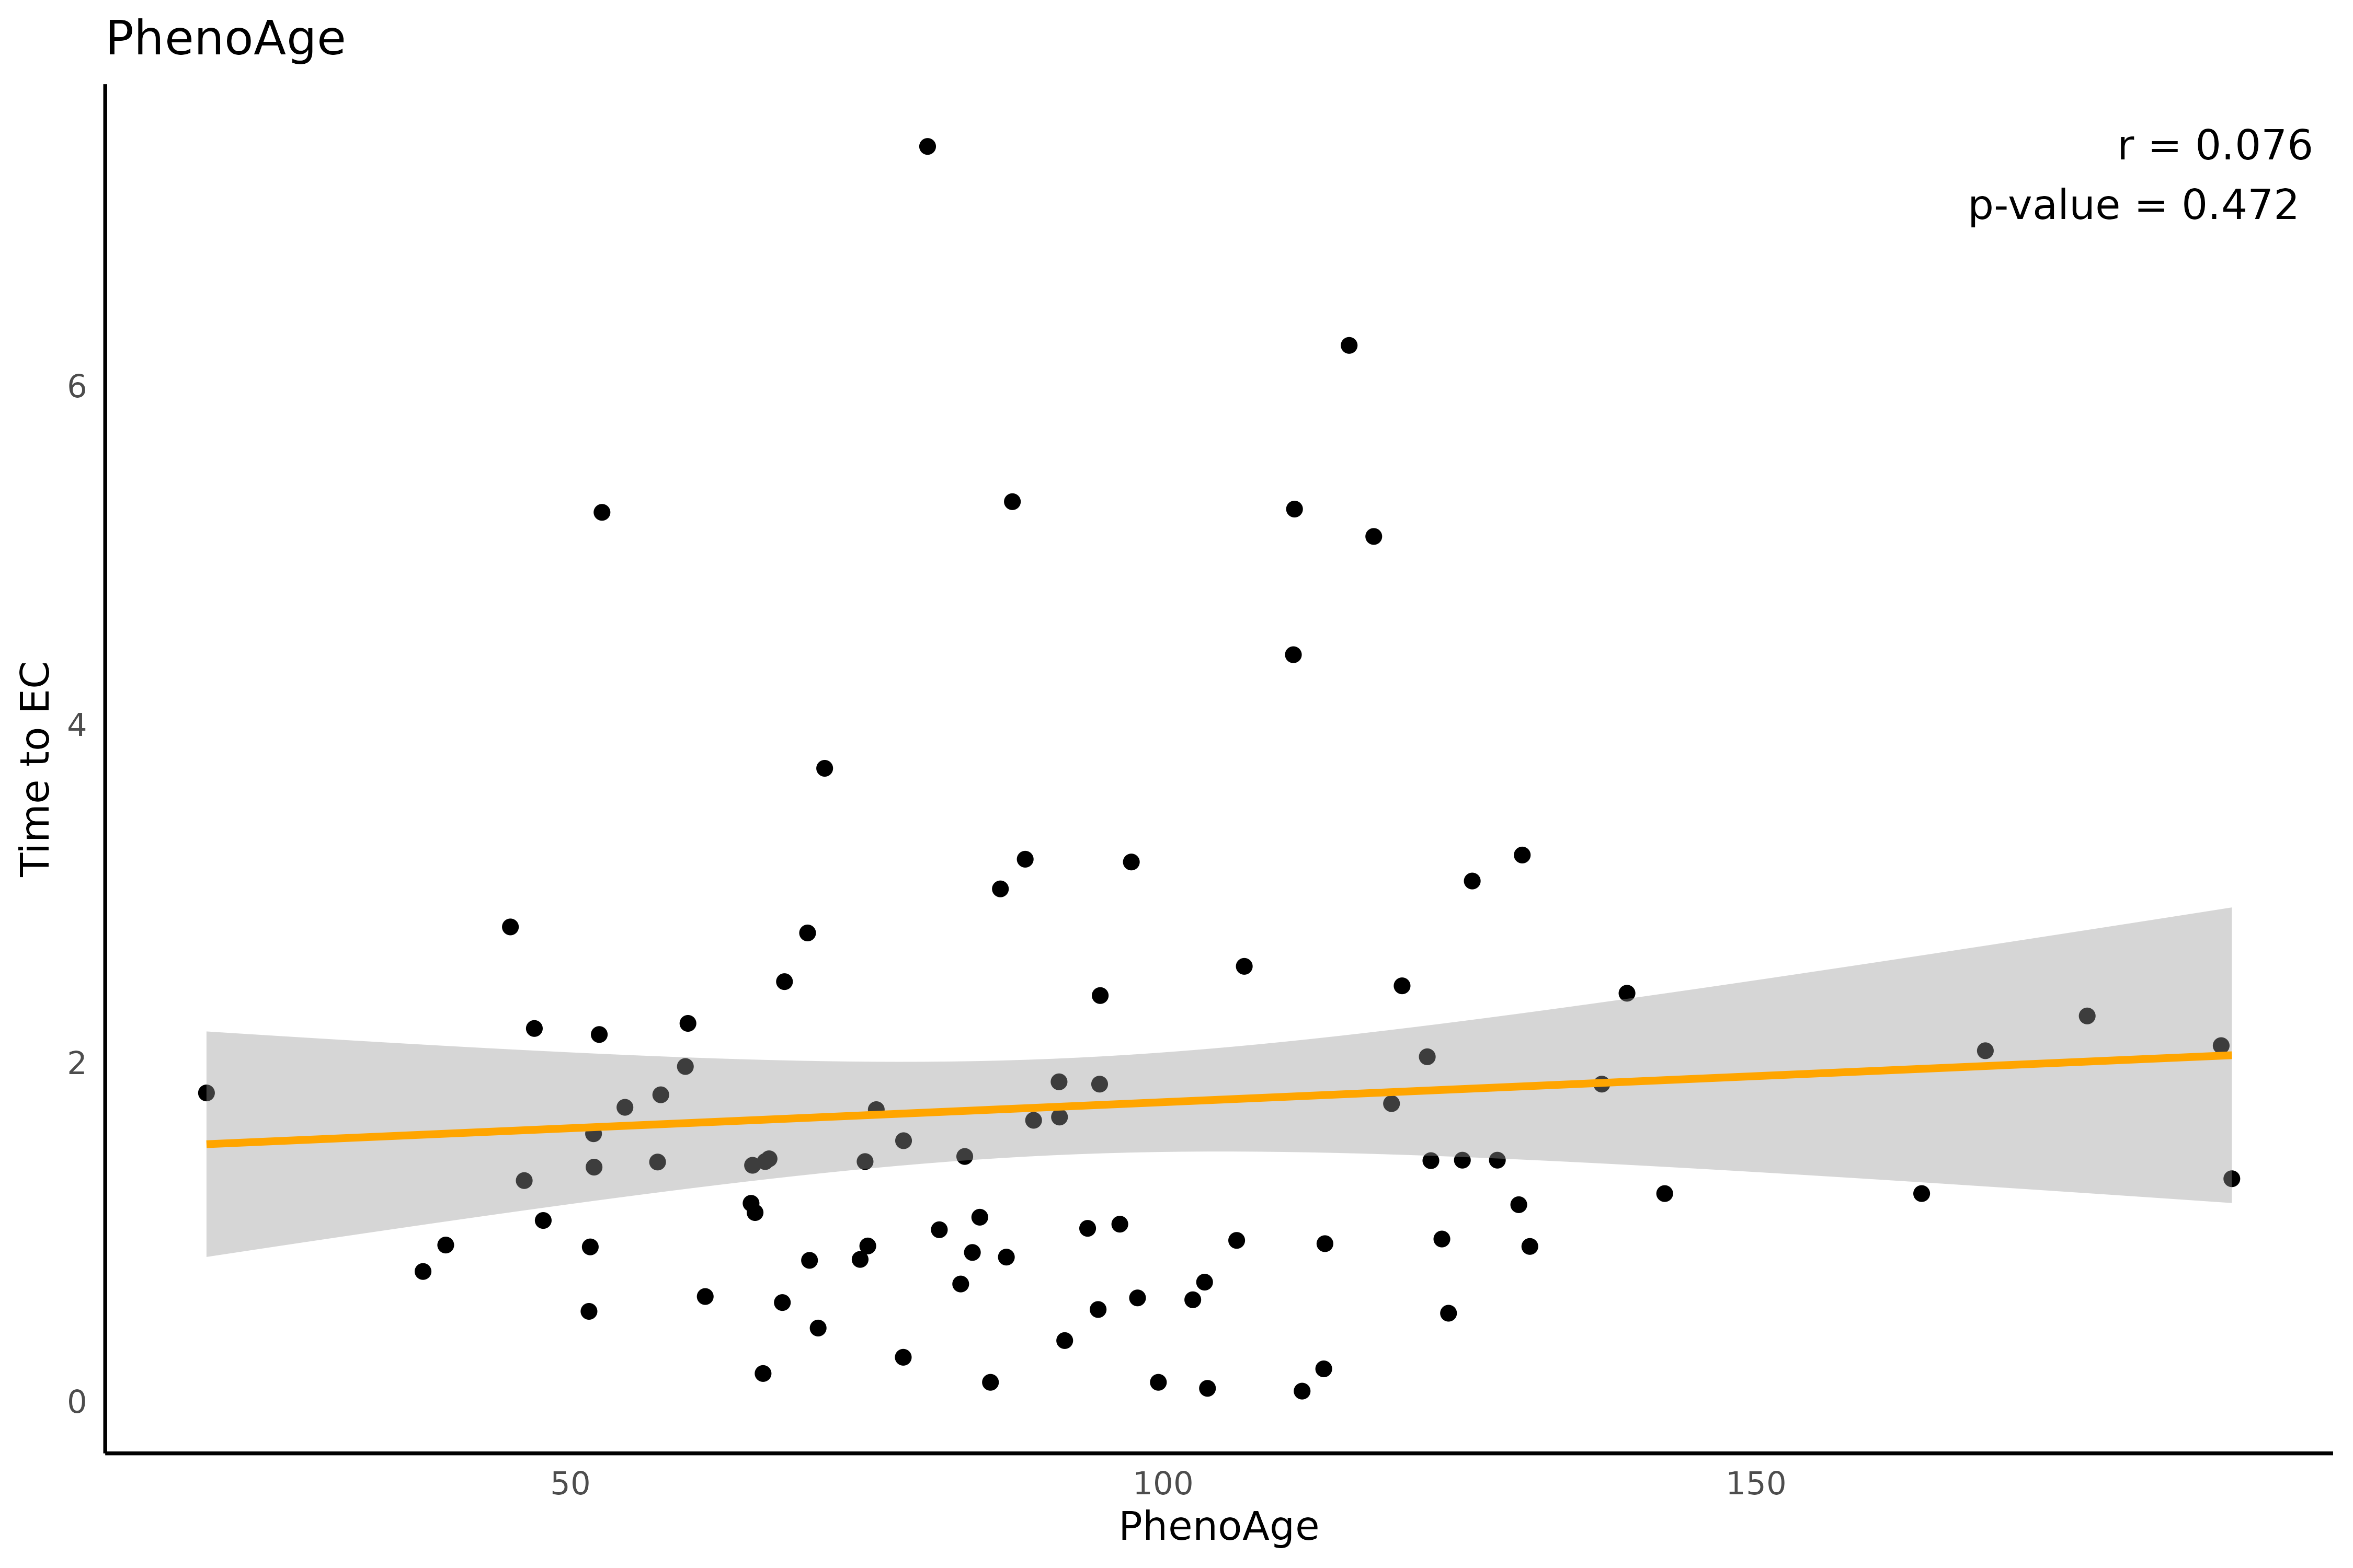
PhenoAge can NOT Predict Future EC in TCGA-UCEC
PhenoAge does NOT correlate with future EC in TCGA-UCEC
Likely due to differences in tissue source
GSE89093 is peripheral blood
Future EC TCGA samples (N=92) did not report biopsy site (likely tumor)

Slide 21
Goal 4: Functional Analysis

Slide 22
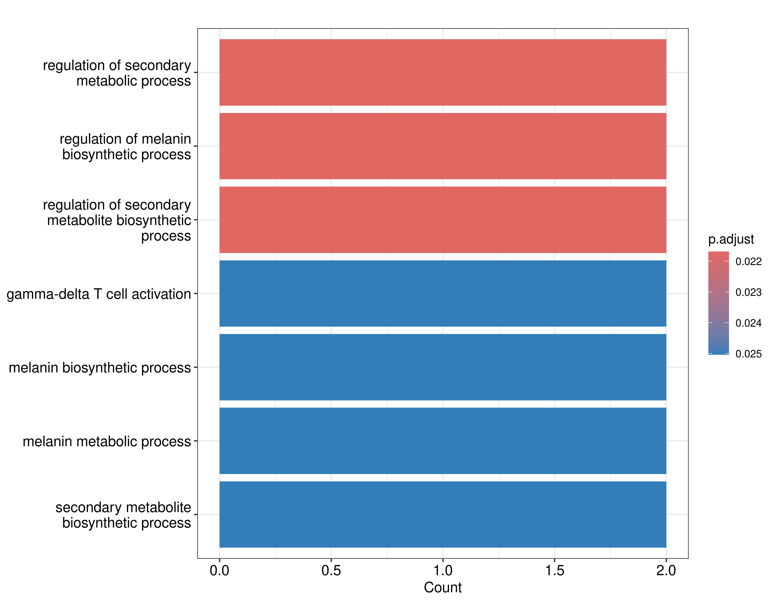
Ontology Enrichment using Penalized Cox Models
Significant probes (146) didn’t lead to any enrichment
Selected 15 non-zero probes using a penalized Cox Proportional Hazards model
BP, MF, CC (ALL)
NO reactome enrichment

Slide 23
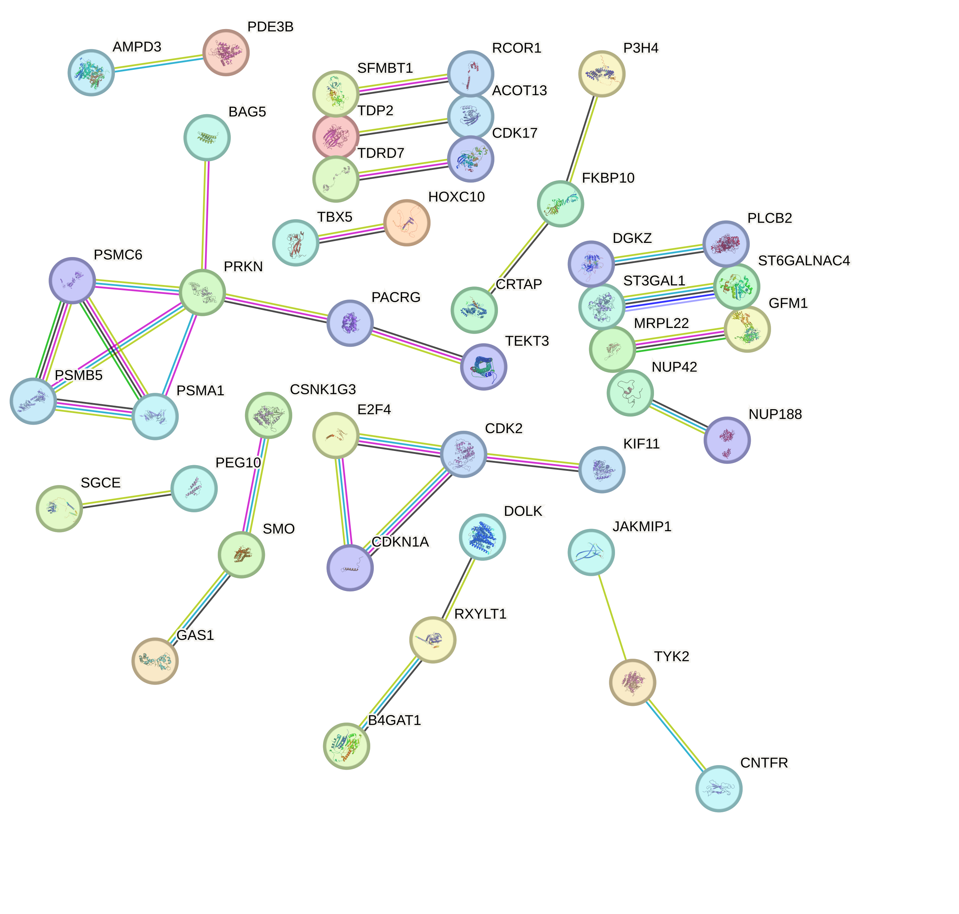
PPI Network (STRING)
146 significant probes | 180 genes
High confidence (interaction score > 0.7)

Slide 24
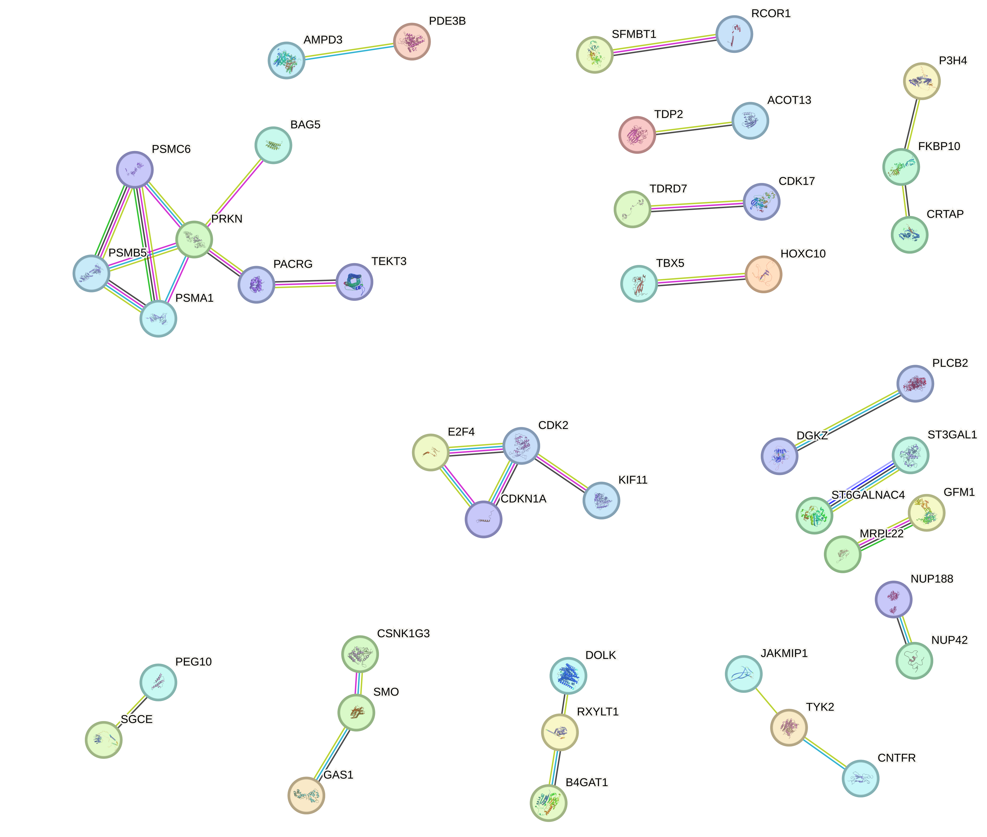
Proteasome System
Mitophagy
Inhibiting it derails mitochondrial homeostasis in cancer (HCC)
Yao et al., 2022
Cell-cycle Regulation
CDK2 regulates G1-S transition
CCNE1 (Cyclin E1) –endometrial and ovarian cancers
House et al., 2025

Slide 25
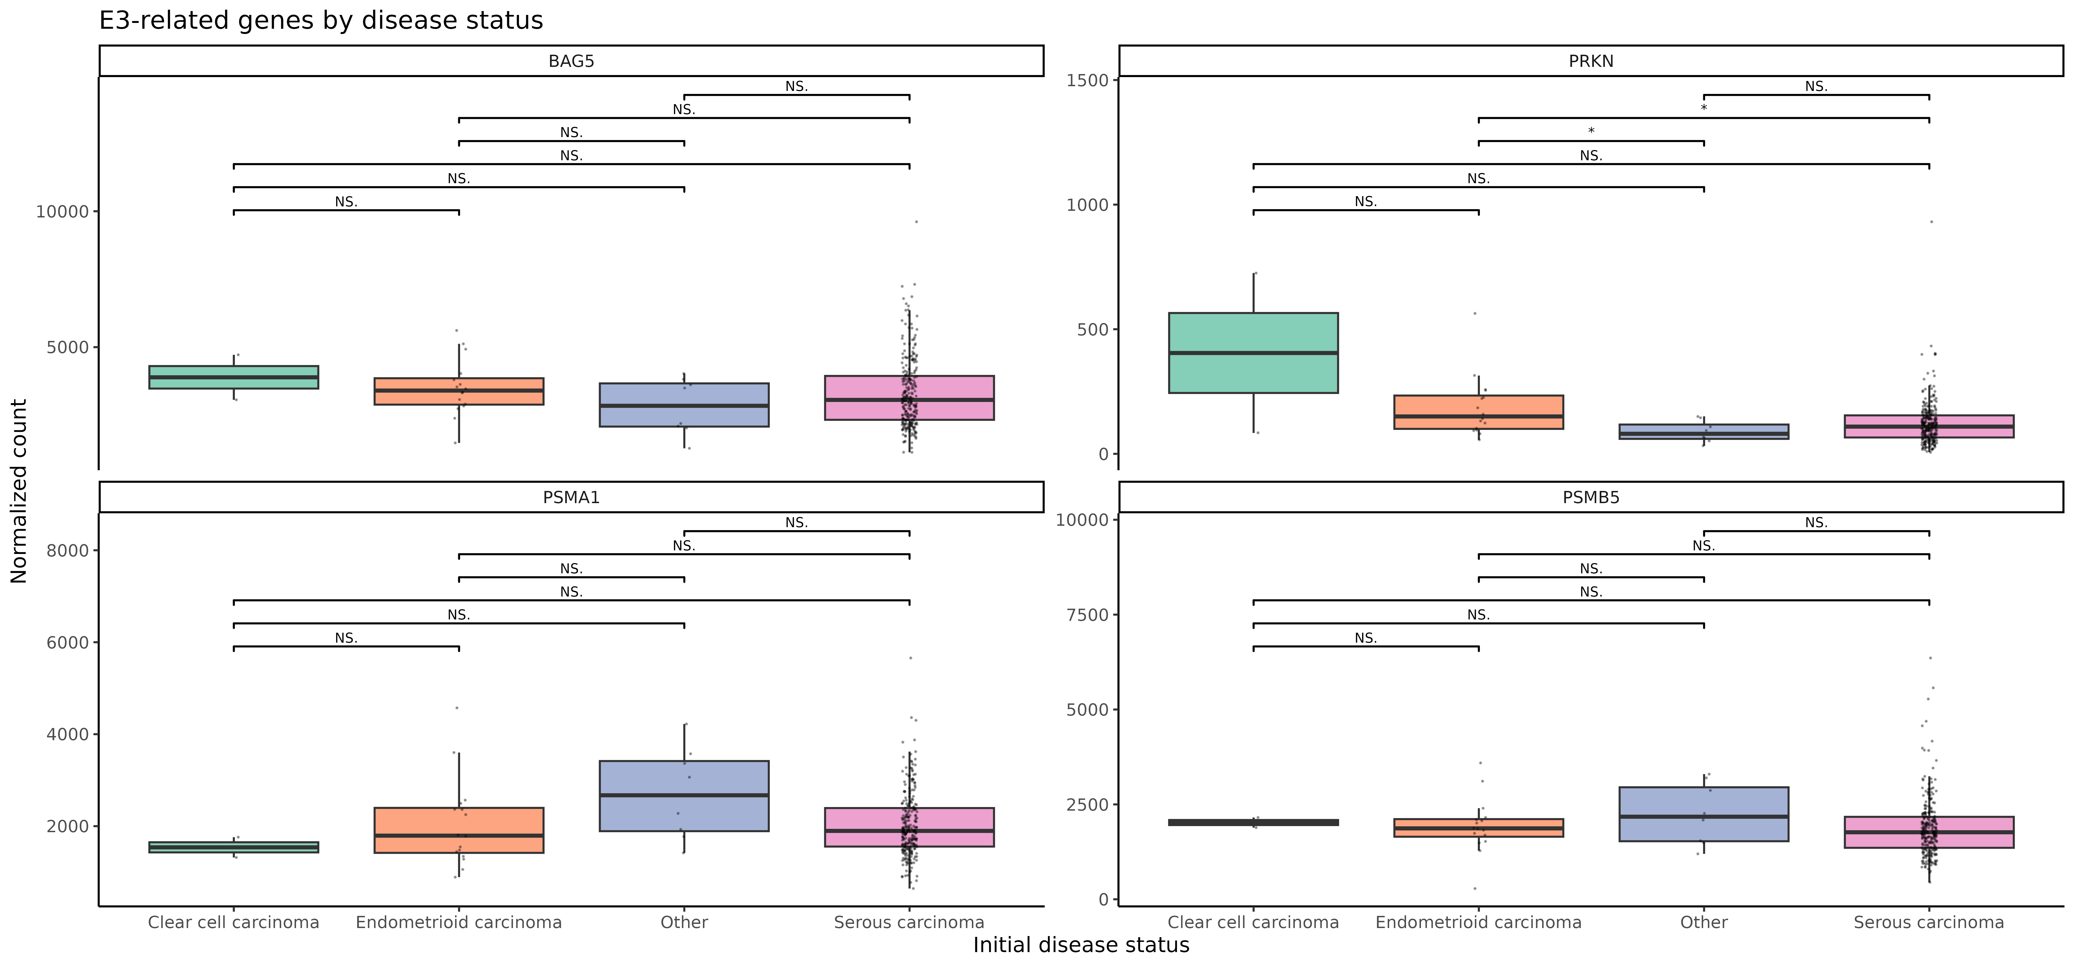
Proteasome Genes Expression (GSE263434 | N=283)

Slide 26
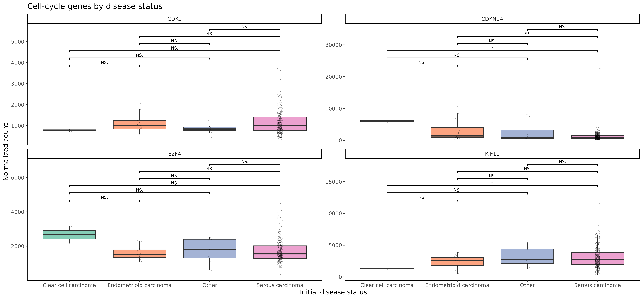
Cell Cycle Genes Expression (GSE263434 | N=283)

Slide 27
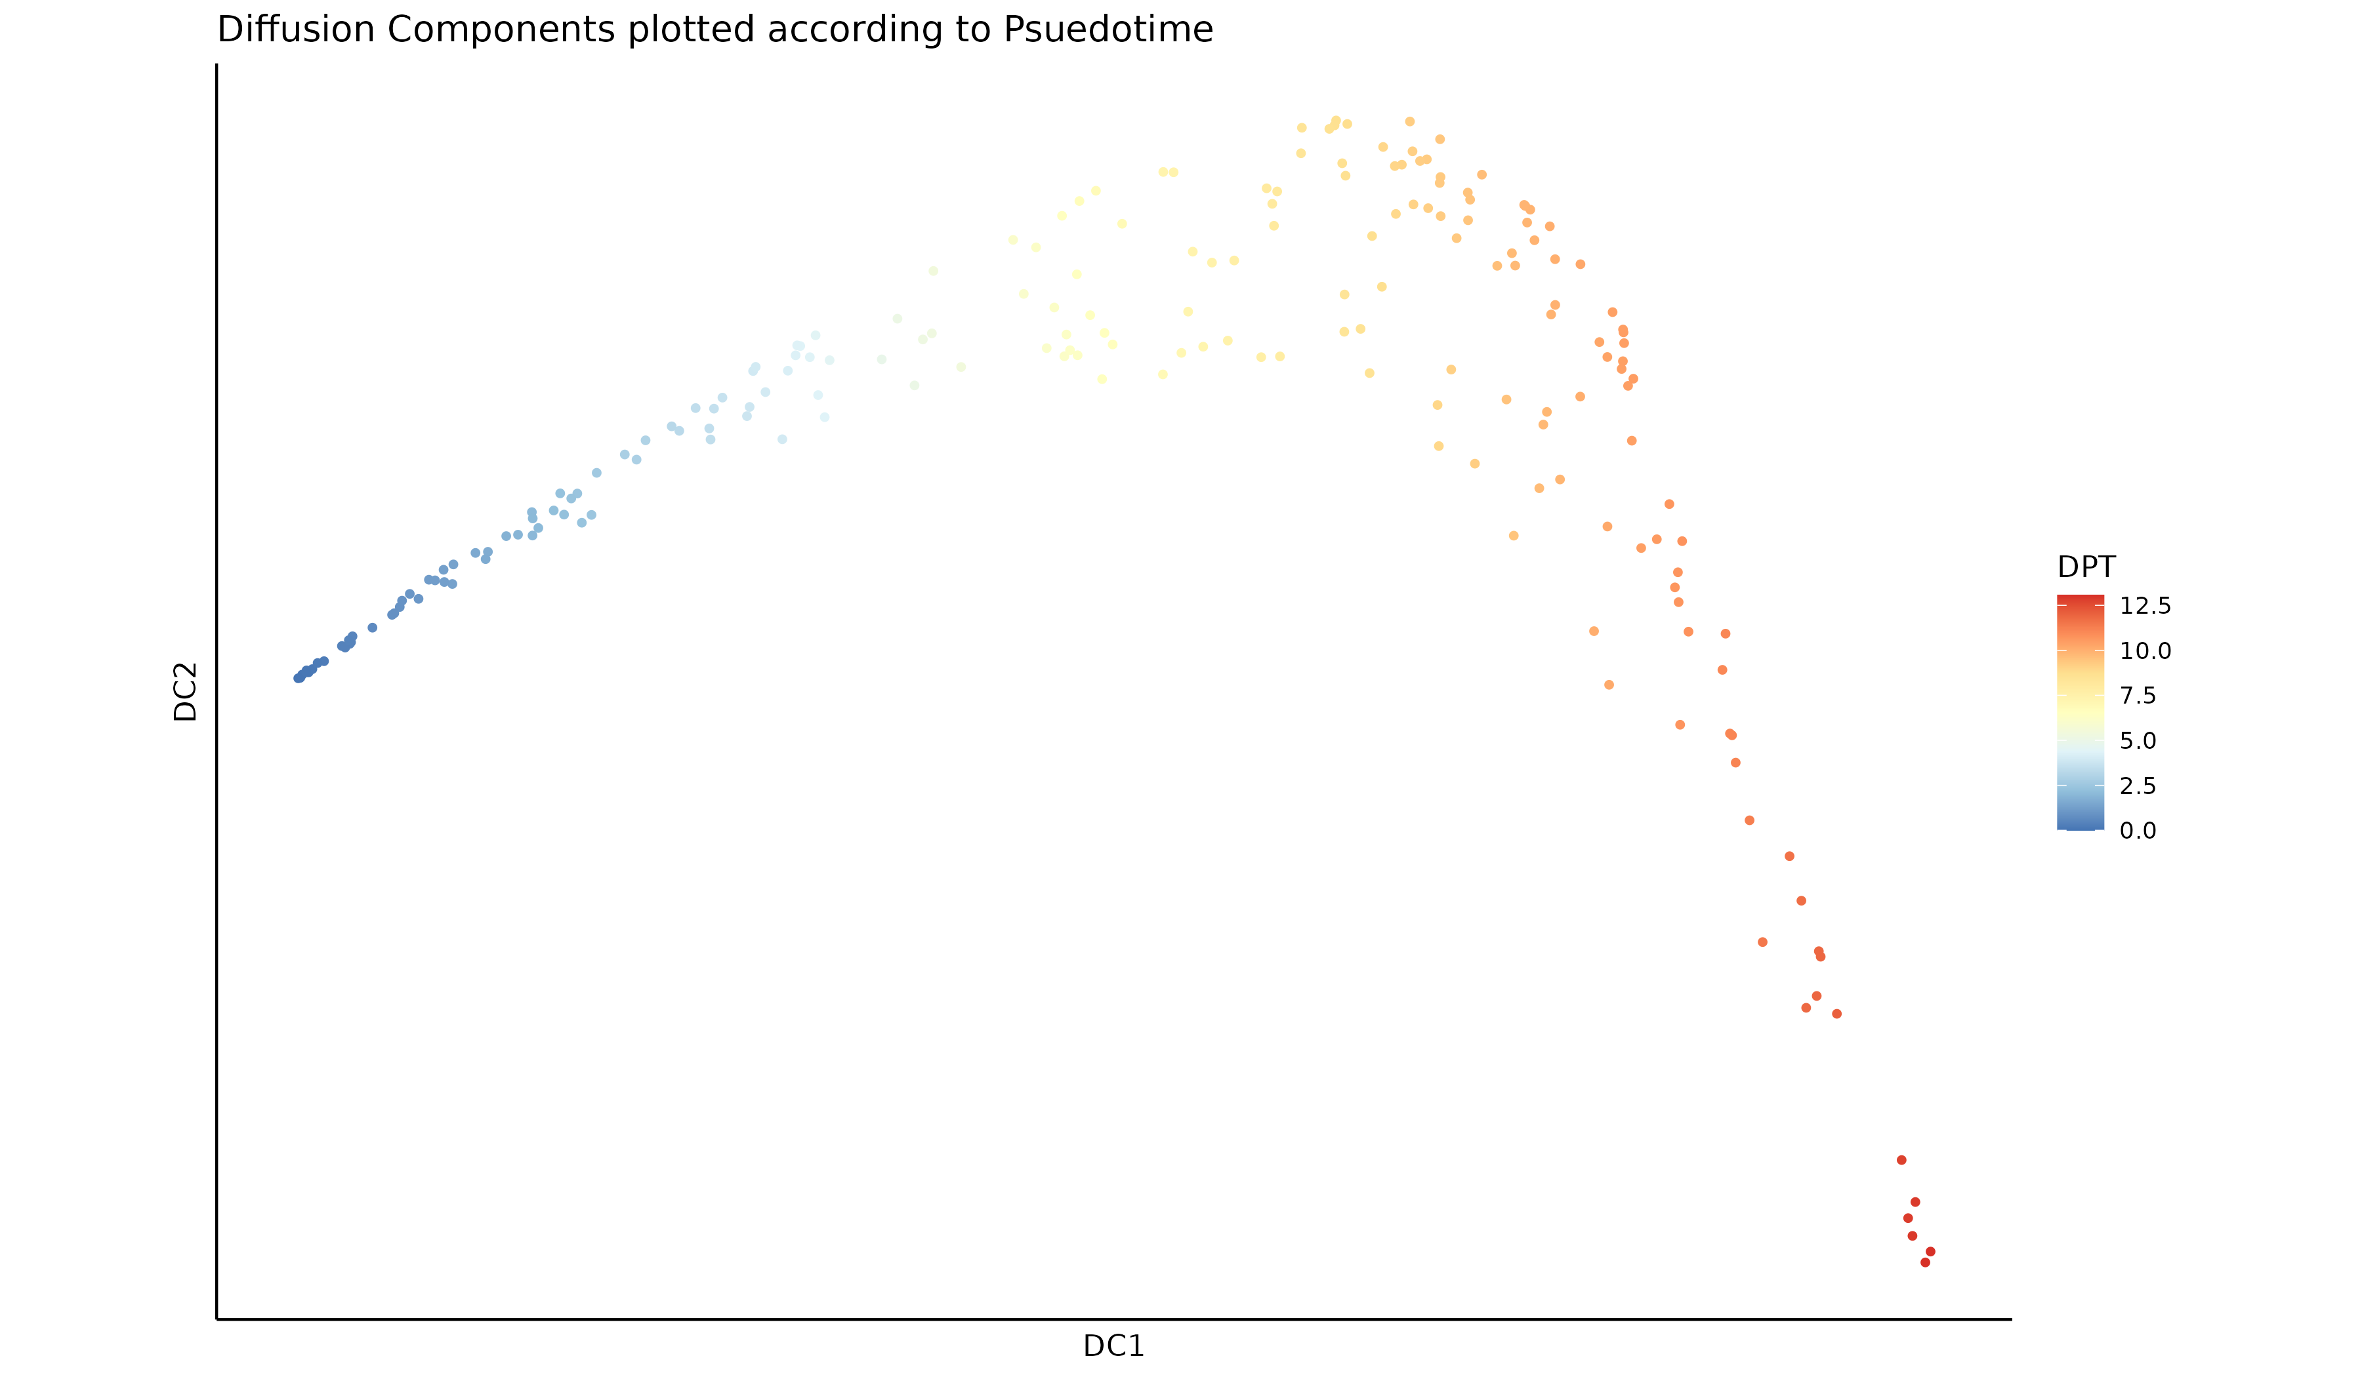
Psuedotime (HAND2 + ADCYAP1 DNAm - TCGA)

Slide 28
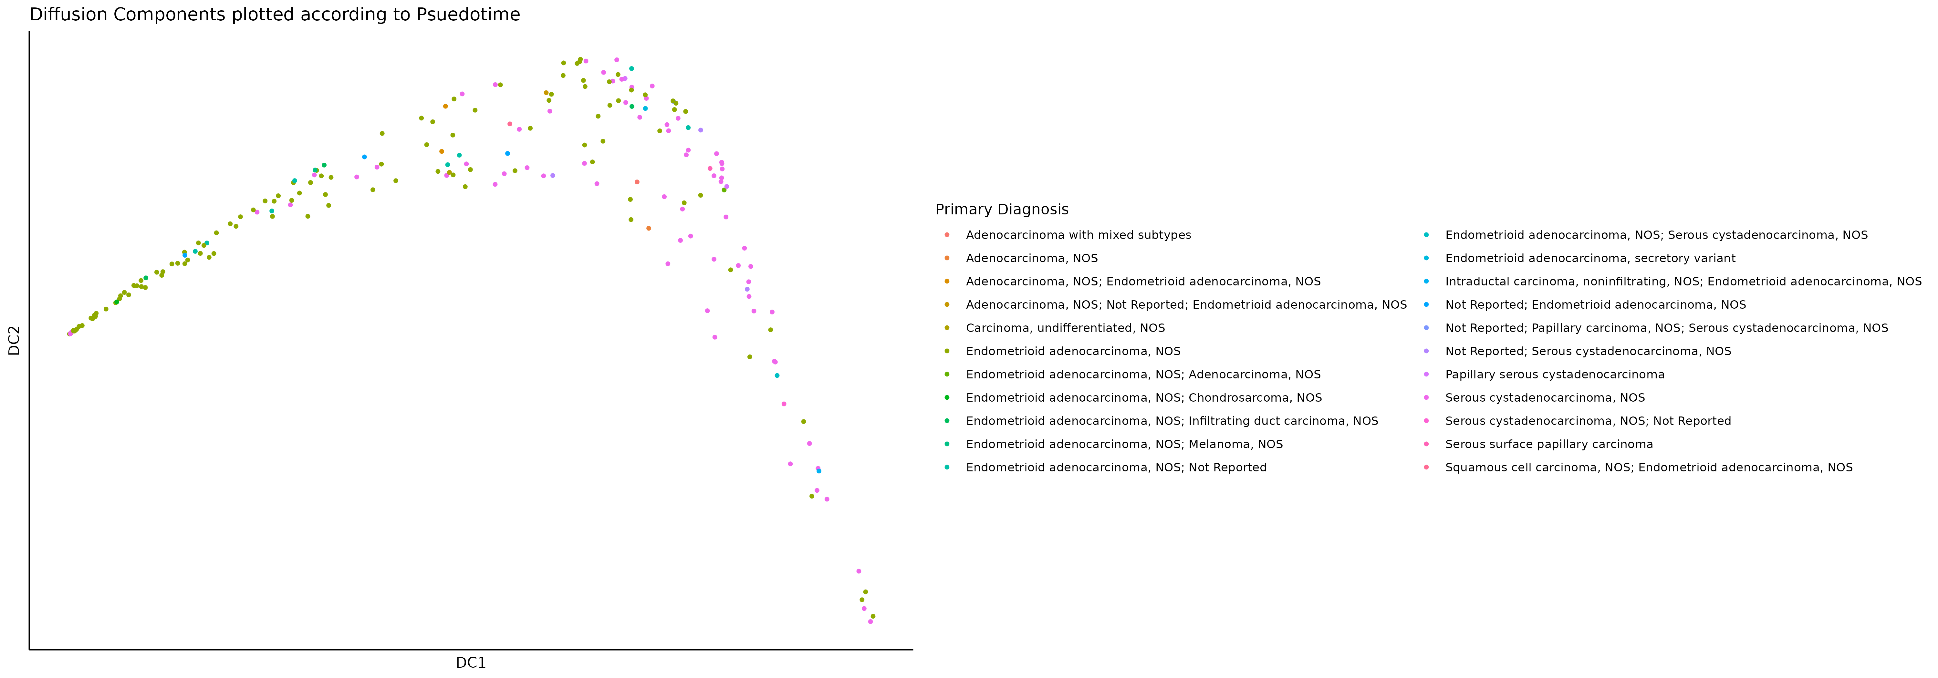
Psuedotime (HAND2 + ADCYAP1 DNAm - TCGA)
Endometroid Adenocarcinoma
Serous Cystadenocarcinoma

Slide 29
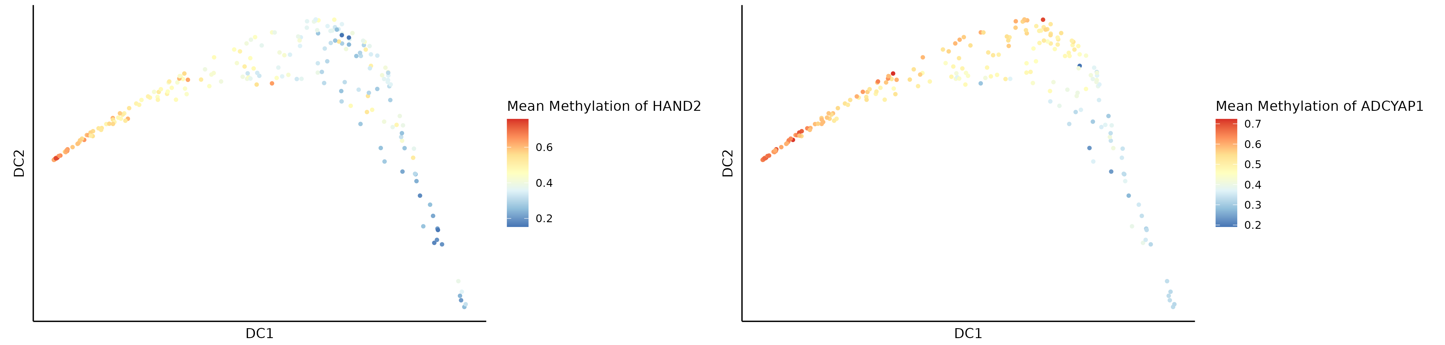
Mean Methylation (HAND2 + ADCYAP1)
Mean methylation of HAND2 and ADCYAP1 is lower in serous carcinomas

Slide 30
Goal 5 & 6: EpiScore & Multi-modal Analysis

Slide 31
Goal 5 & 6 Incomplete
Did not identify any new CpG (set) that could be used to predict future EC.
PhenoAge is already published.
Did not extend the analysis to other modalities due to lack of success in goal 3.

Slide 32
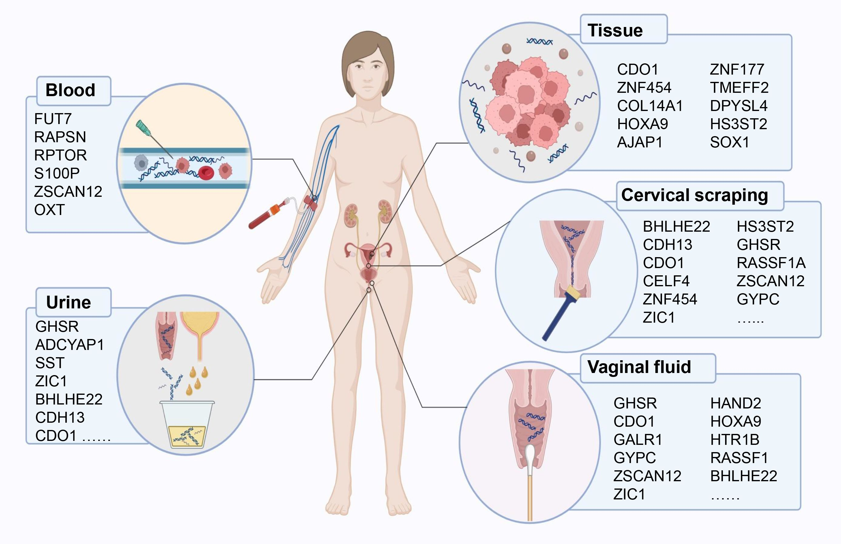
Possible Future Analysis
Li et al., 2025

Slide 33

Thanks for Listening!
Happy to answer any questions :)

Slide 34
References
Yao, J., Wang, J., Xu, Y., Guo, Q., Sun, Y., Liu, J., Li, S., Guo, Y., & Wei, L. (2022). CDK9 inhibition blocks the initiation of PINK1-PRKN-mediated mitophagy by regulating the SIRT1-FOXO3-BNIP3 axis and enhances the therapeutic effects involving mitochondrial dysfunction in hepatocellular carcinoma. Autophagy, 18(8), 1879–1897. https://doi.org/10.1080/15548627.2021.2007027
Multinu, F., Chen, J., Madison, J. D., Torres, M., Casarin, J., Visscher, D., Shridhar, V., Bakkum-Gamez, J., Sherman, M., Wentzensen, N., Mariani, A., & Walther-Antonio, M. (2020). Analysis of DNA methylation in endometrial biopsies to predict risk of endometrial cancer. Gynecologic oncology, 156(3), 682–688. https://doi.org/10.1016/j.ygyno.2019.12.023
House, N. C., Brown, V. E., Chen, M., Yuan, L., Moore, S. L., Guo, J., Choi, Y. J., Muthuswamy, L., Ribich, S., Ramsden, P., & Faia, K. L. (2025). Profiling the Activity of the Potent and Highly Selective CDK2 Inhibitor BLU-222 Reveals Determinants of Response in CCNE1-Aberrant Ovarian and Endometrial Tumors. Cancer research, 85(7), 1297–1309. https://doi.org/10.1158/0008-5472.CAN-24-2360
Li, M., Xia, Z., Wang, R., Xi, M., & Hou, M. (2025). Unveiling DNA methylation: early diagnosis, risk assessment, and therapy for endometrial cancer. Frontiers in oncology, 14, 1455255. https://doi.org/10.3389/fonc.2024.1455255

Slide 35
Supplementary

Slide 36
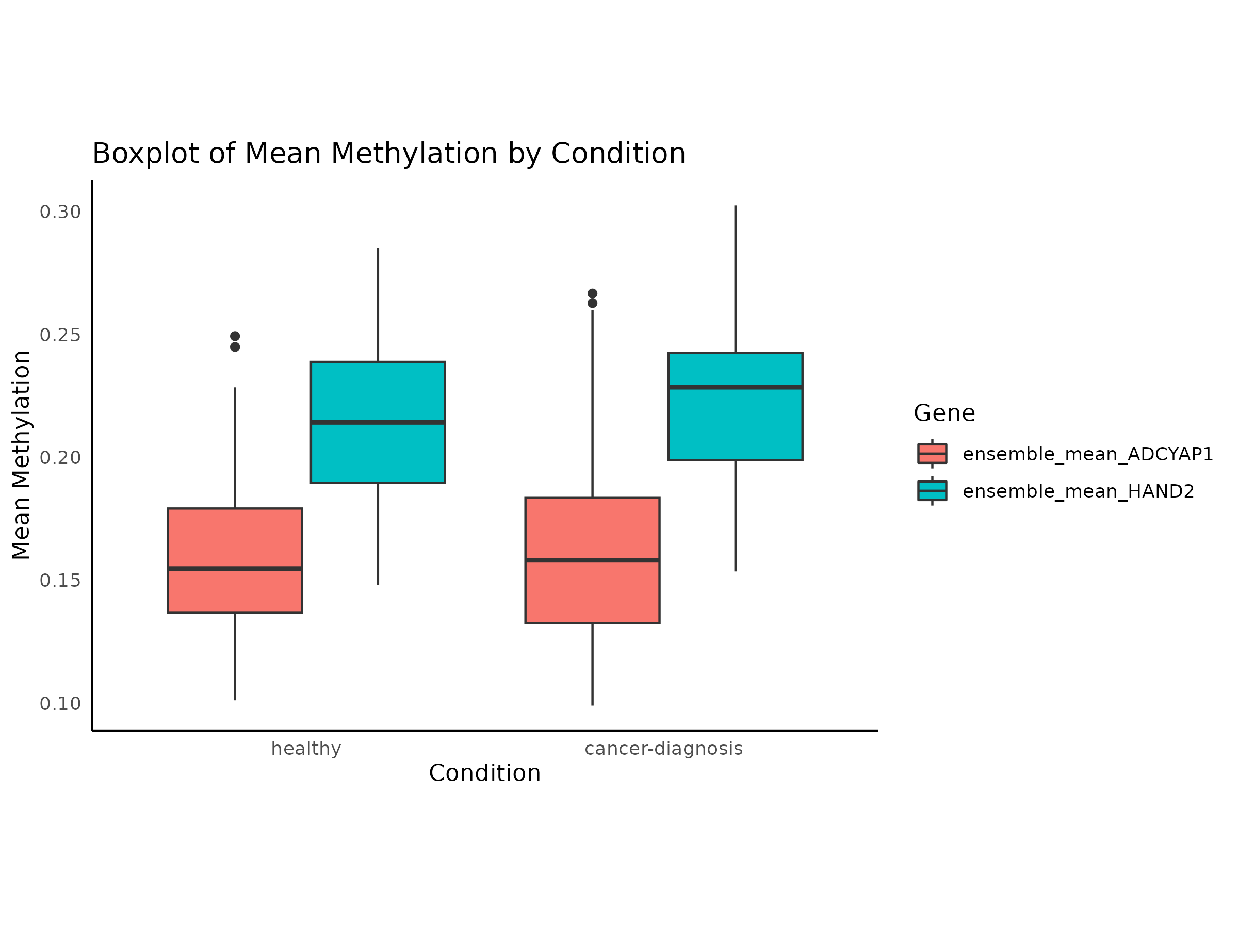
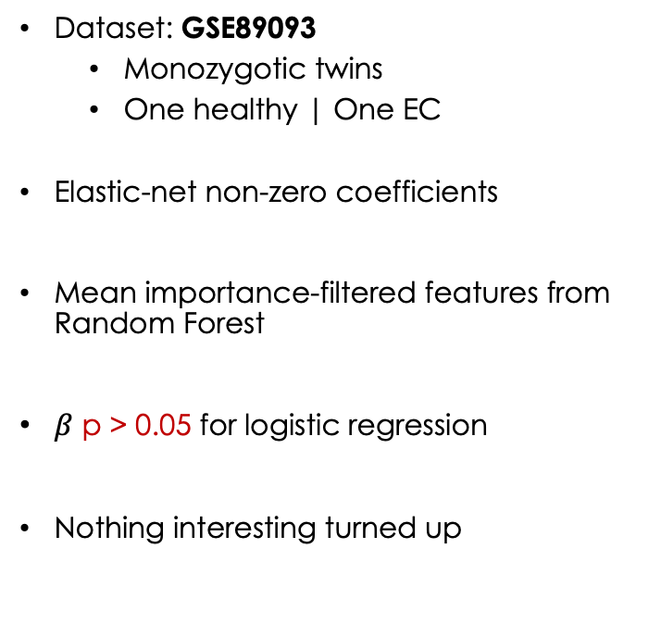
Ensemble Method for Feature Selection
Dataset: GSE89093
Monozygotic twins
One healthy | One EC
Elastic-net non-zero coefficients
Mean importance-filtered features from Random Forest
$β$ p > 0.05 for logistic regression
Nothing interesting turned up
ADCYAP1
HAND2

Slide 37
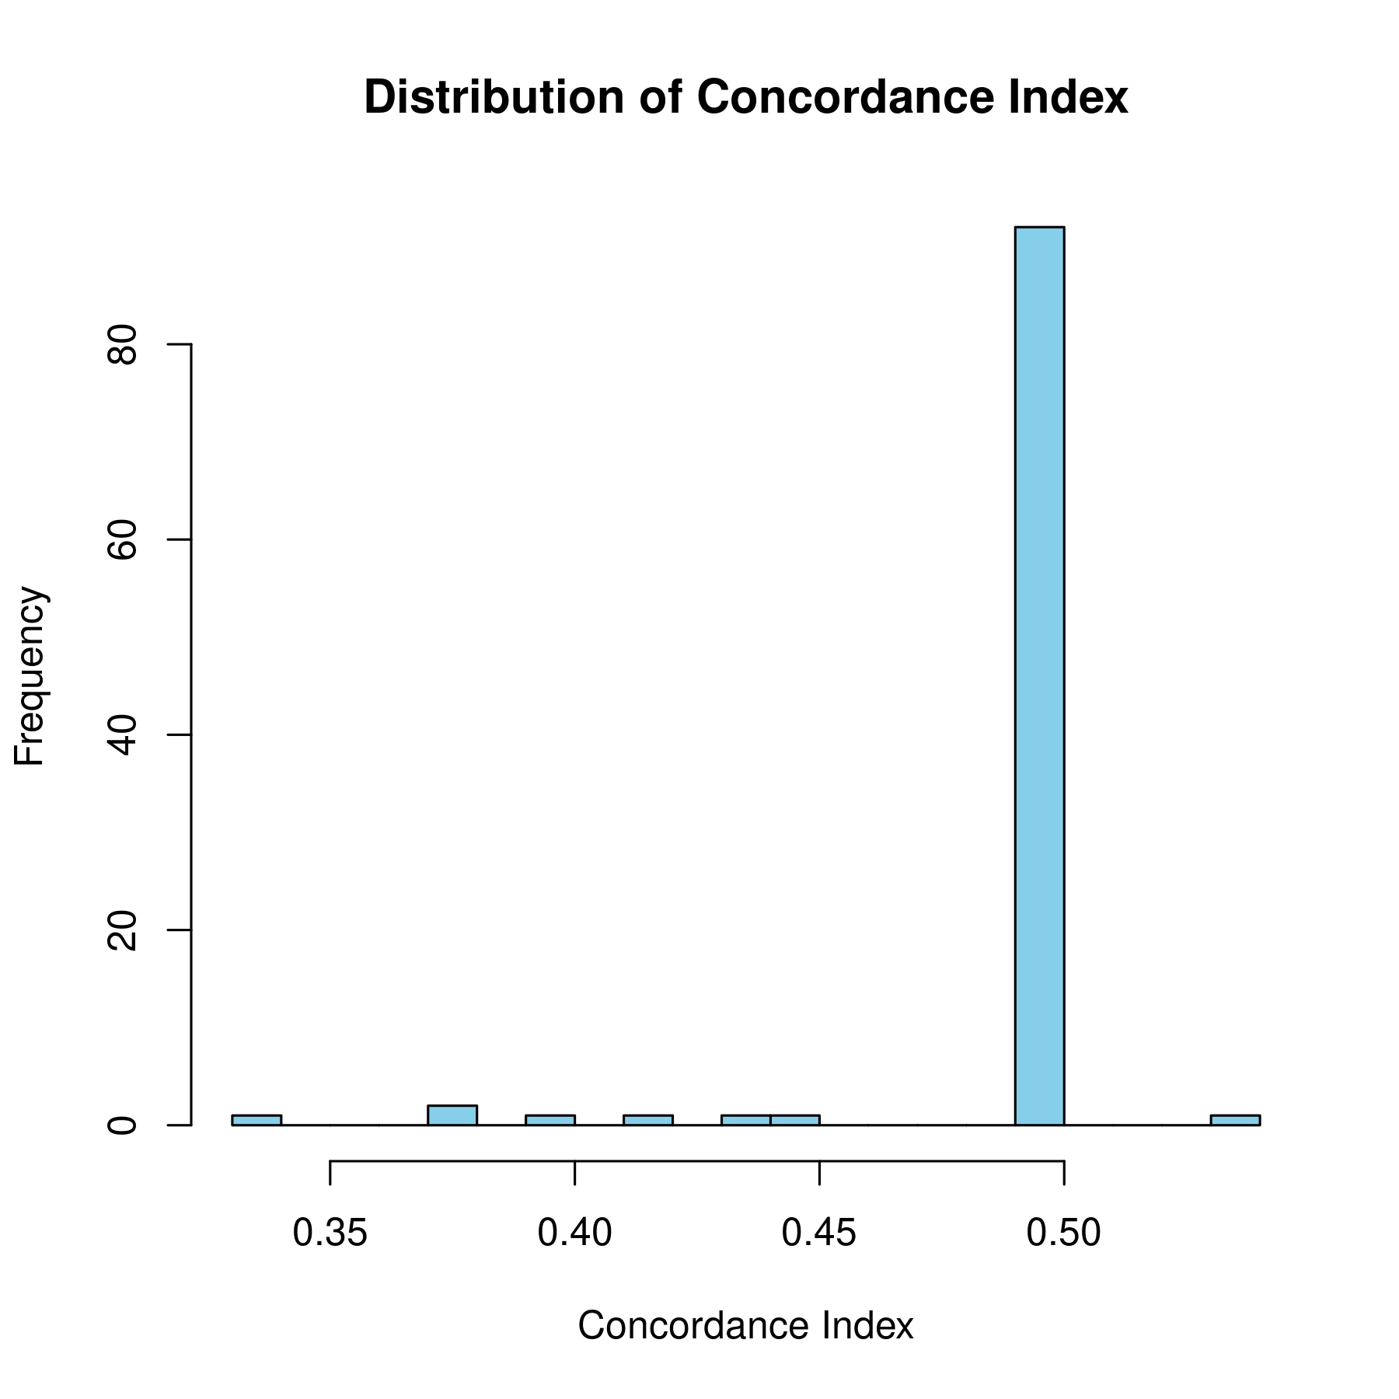
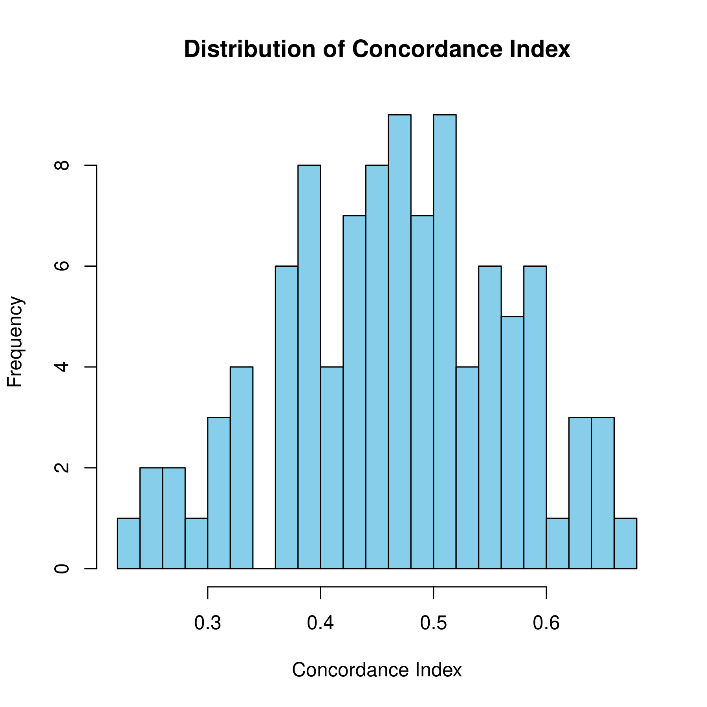
Survival Analysis
ADCYAP1 Elastic-net
Bootstraps: 100
A more flexible model produced larger values of CI.
There’s a non-linear relationship between survival and DNAm.
Switched to non-linear random survival forest (RSF).
Tried the following with all CpGs:
Ridge with both ADCYAP1 and HAND2.
RSF with ADCYAP1 and HAND2 individually.
RSF with both ADCYAP1 and HAND2.
ADCYAP1 Ridge

Slide 38
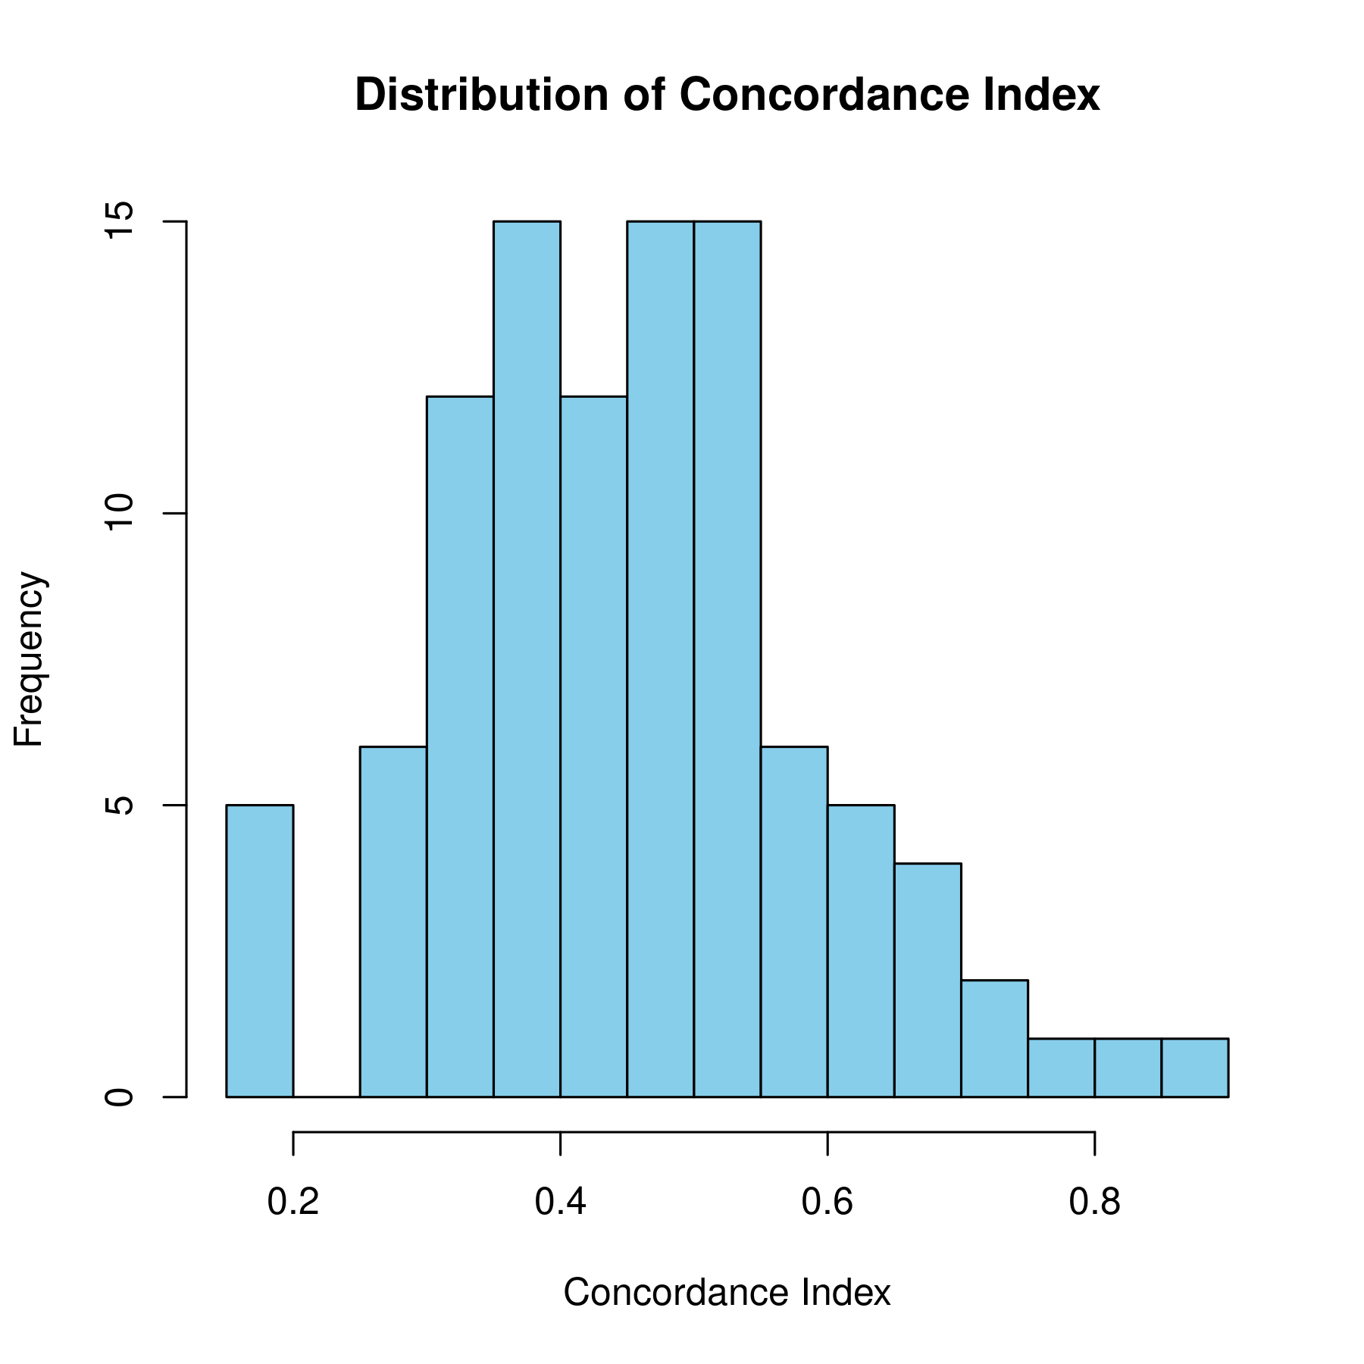
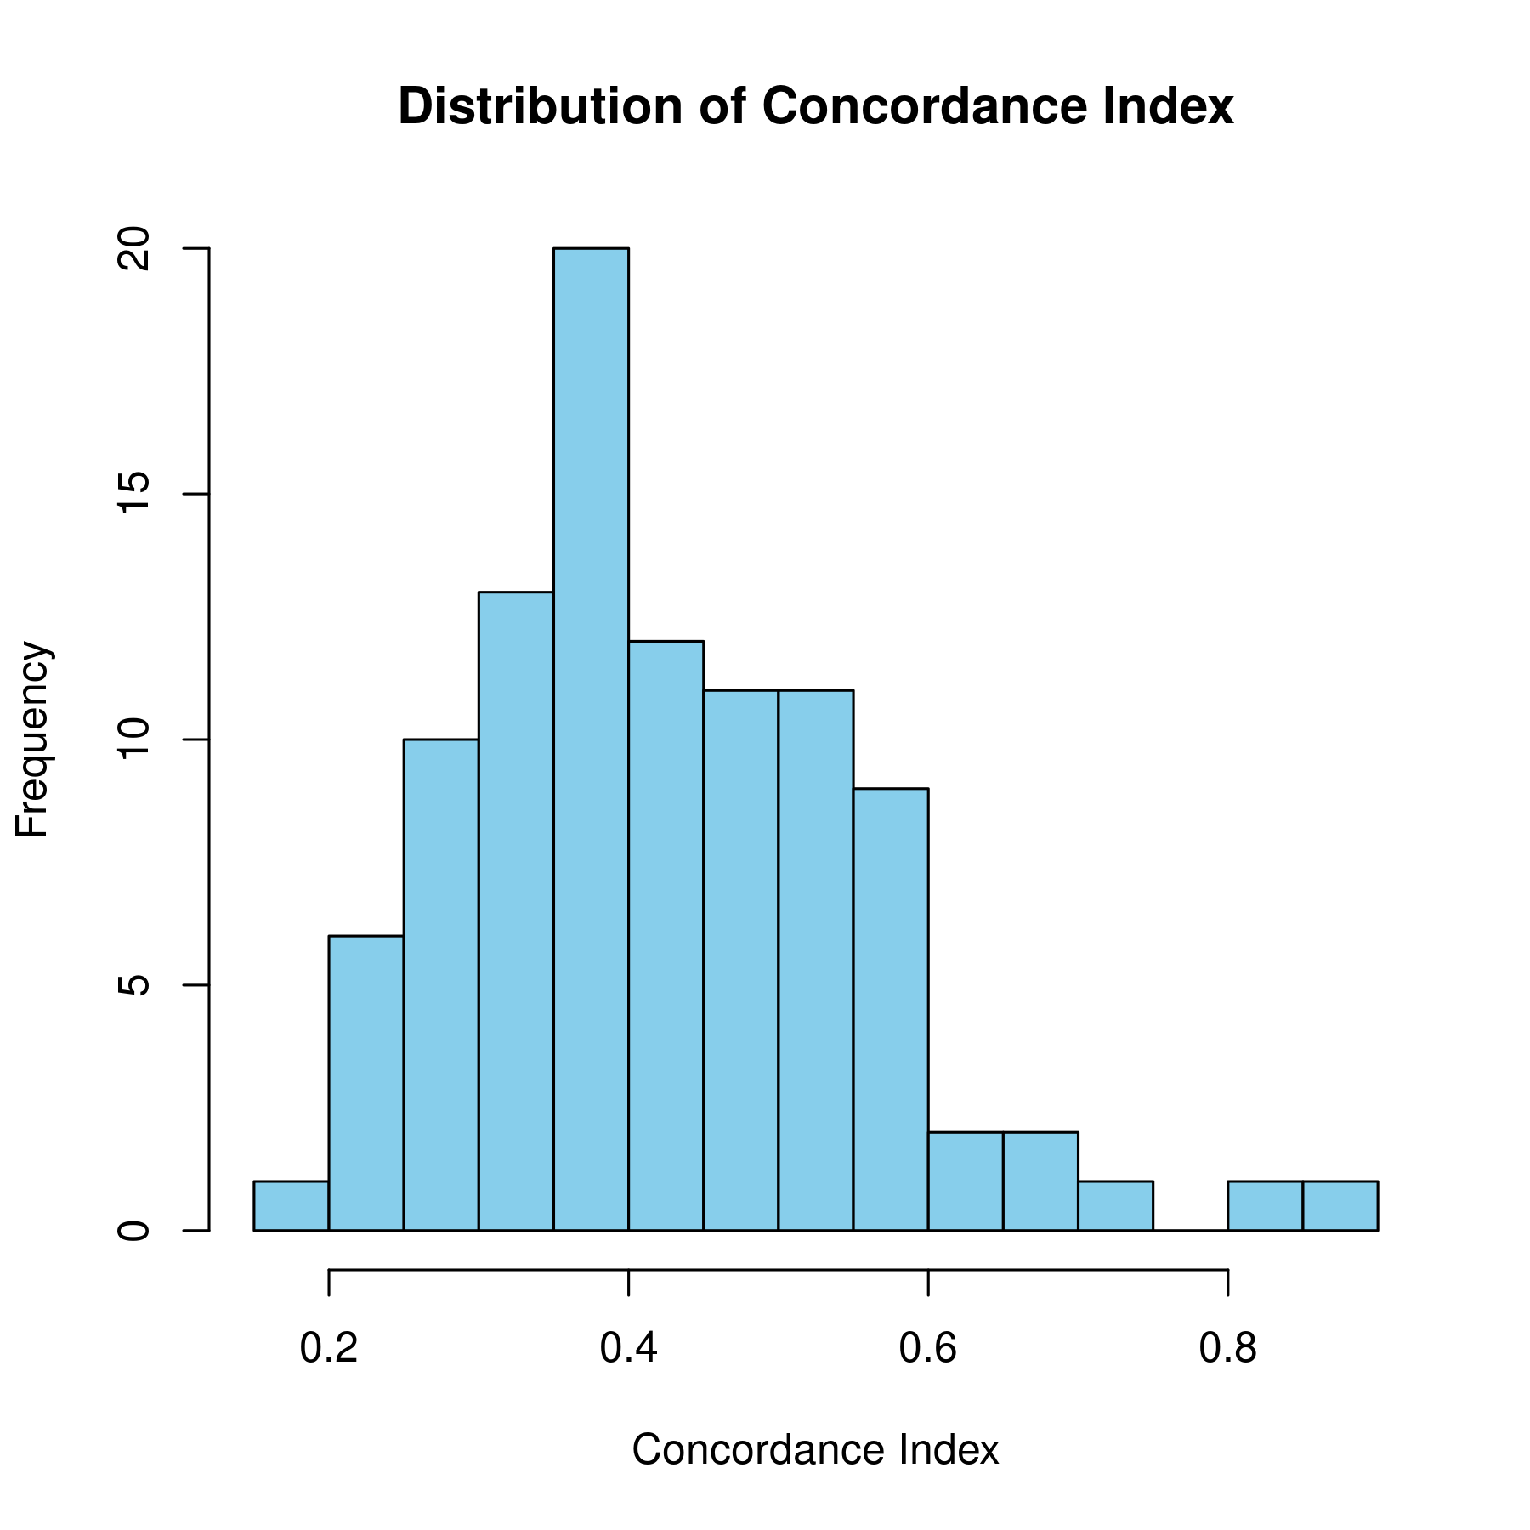
Survival Analysis (Future EC)
ADCYAP1 RSF
HAND2
RSF

Slide 39
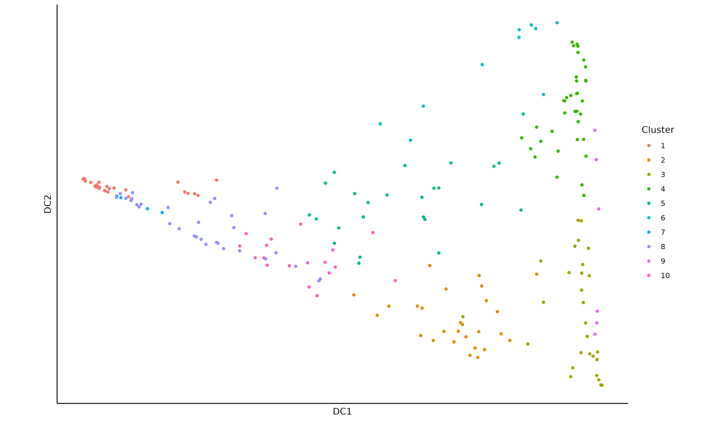
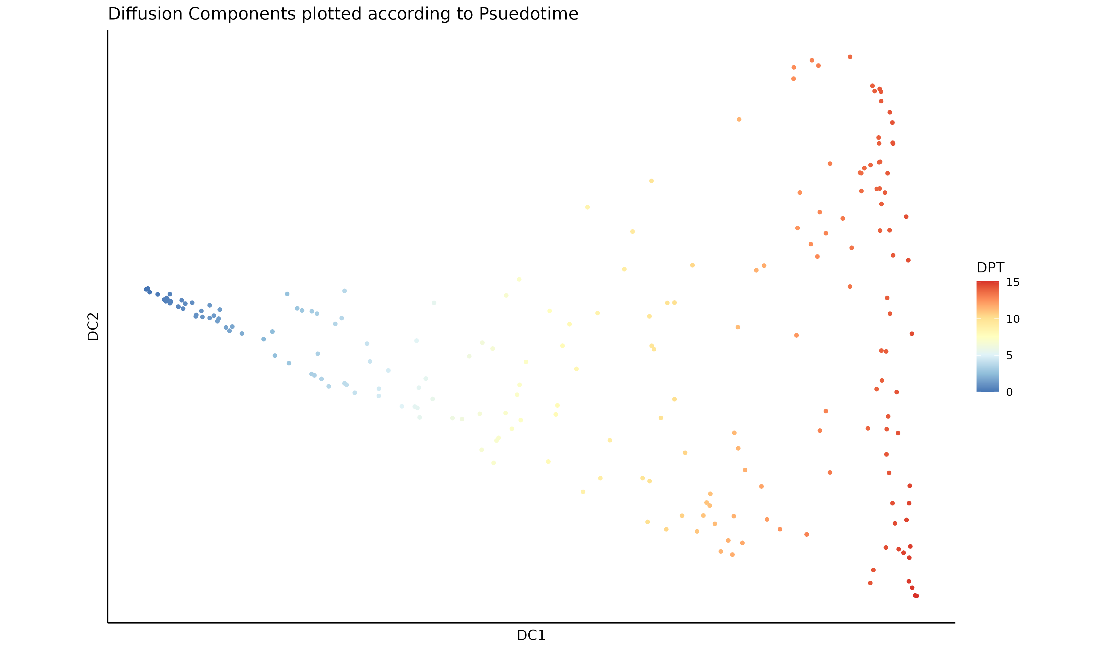
Psuedotime (HAND2 DNAm - TCGA)

Slide 40
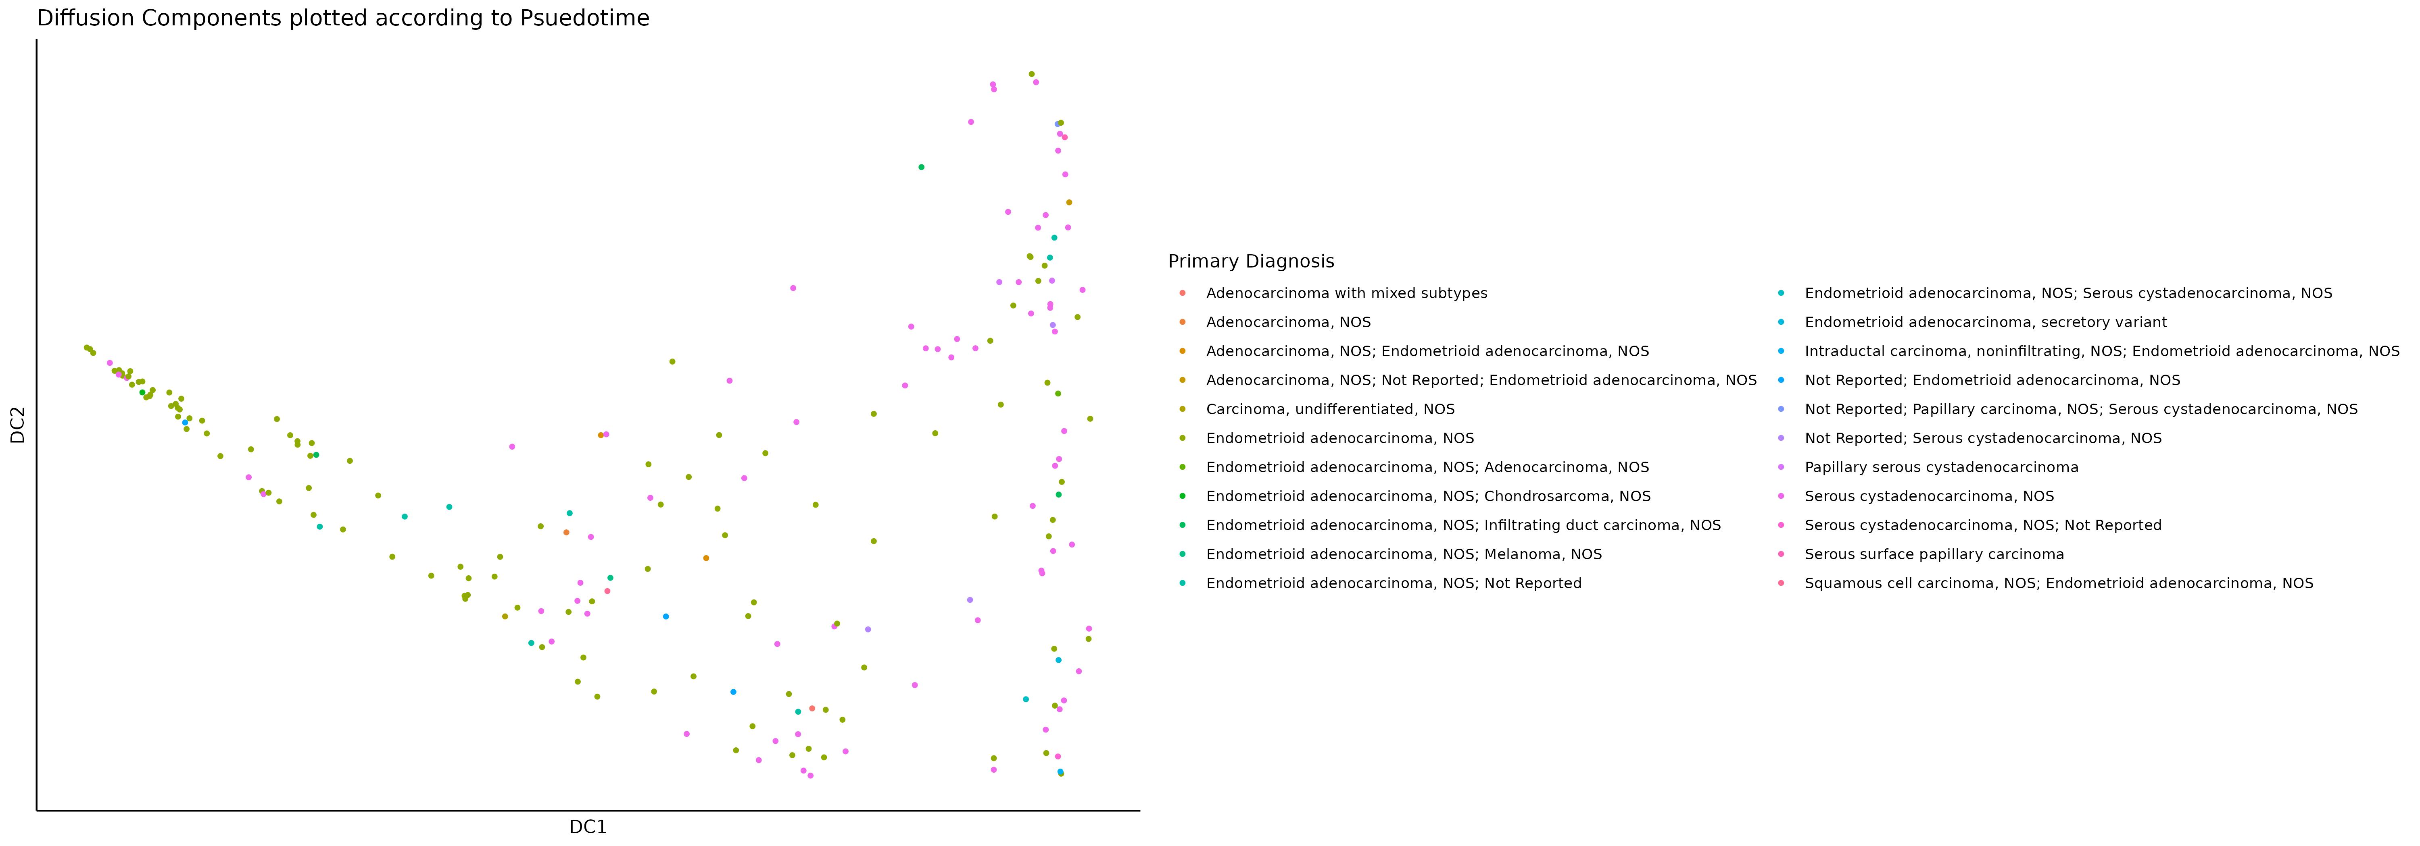
Psuedotime (HAND2 DNAm - TCGA)
Endometroid Adenocarcinoma
Serous Cystadenocarcinoma

Slide 41
Mean Methylation (HAND2 + ADCYAP1)
Mean methylation of HAND2 and ADCYAP1 is lower in serous carcinomas

Slide 42
Feature Engineering (CpG x Gene)
Dataset: GSE263434
LM to identify probes significantly associated with gene expression (padj < 0.05)
Survival analysis
Psuedotime analysis
Weighted sum of CpG x Gene expression
PCA
$$Σ \left(β value of CpG × Coefficient\right)+RNAseq value of Gene$$
Spoilers: nothing worked

Slide 43
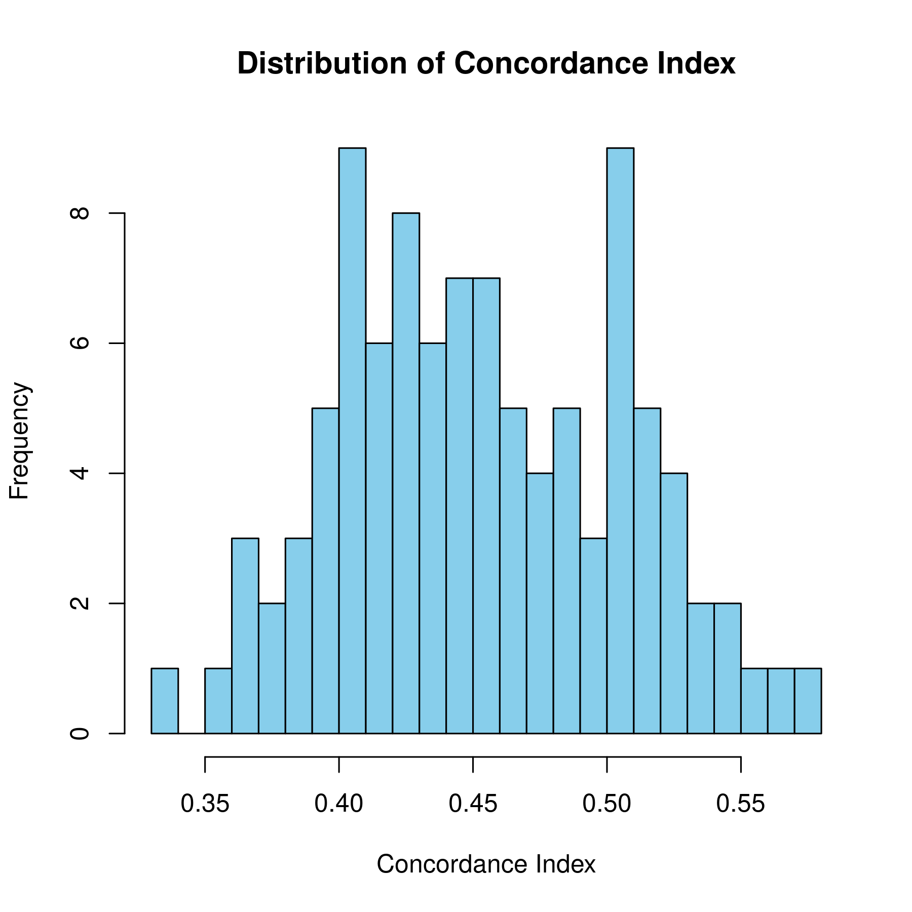
Engineered Features Survival Analysis
Bootstraps: 100
Model: Random survival forest (RSF).
Didn’t help much.
Neither did pseudotime.
So it was basically a waste.

Slide 44
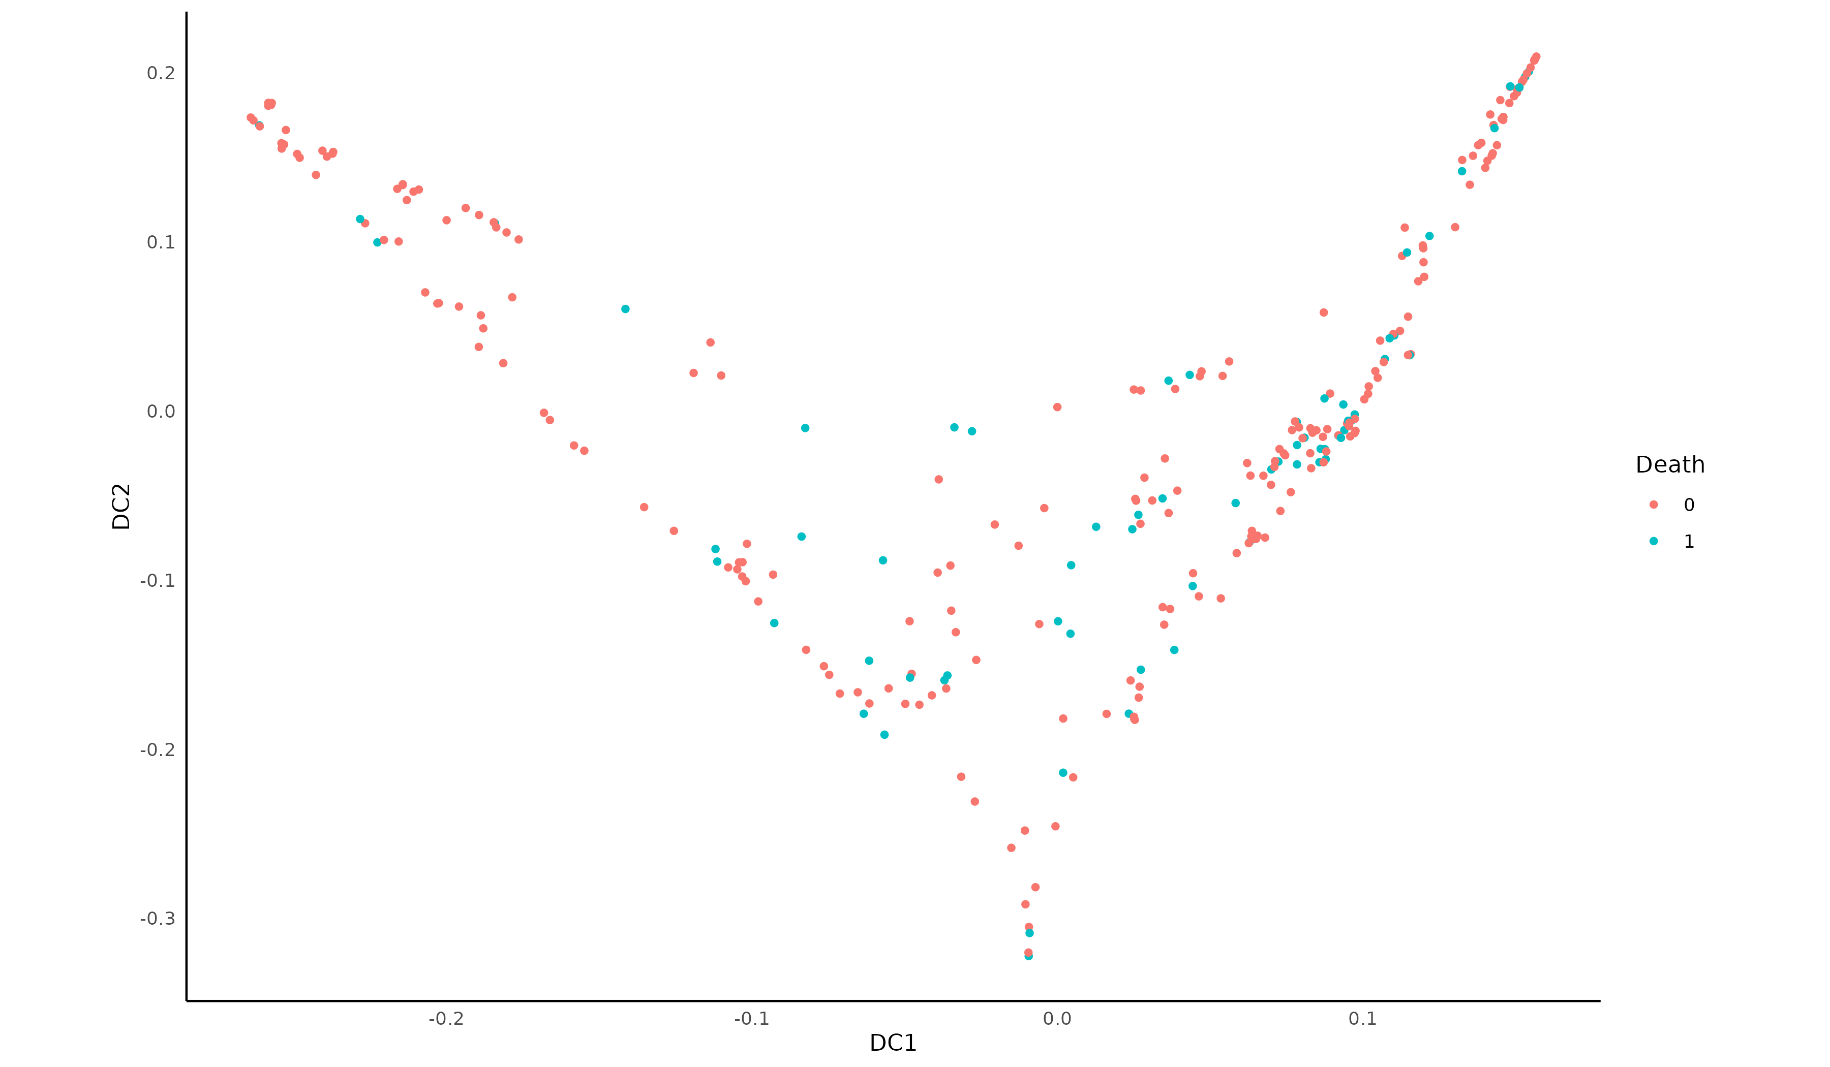
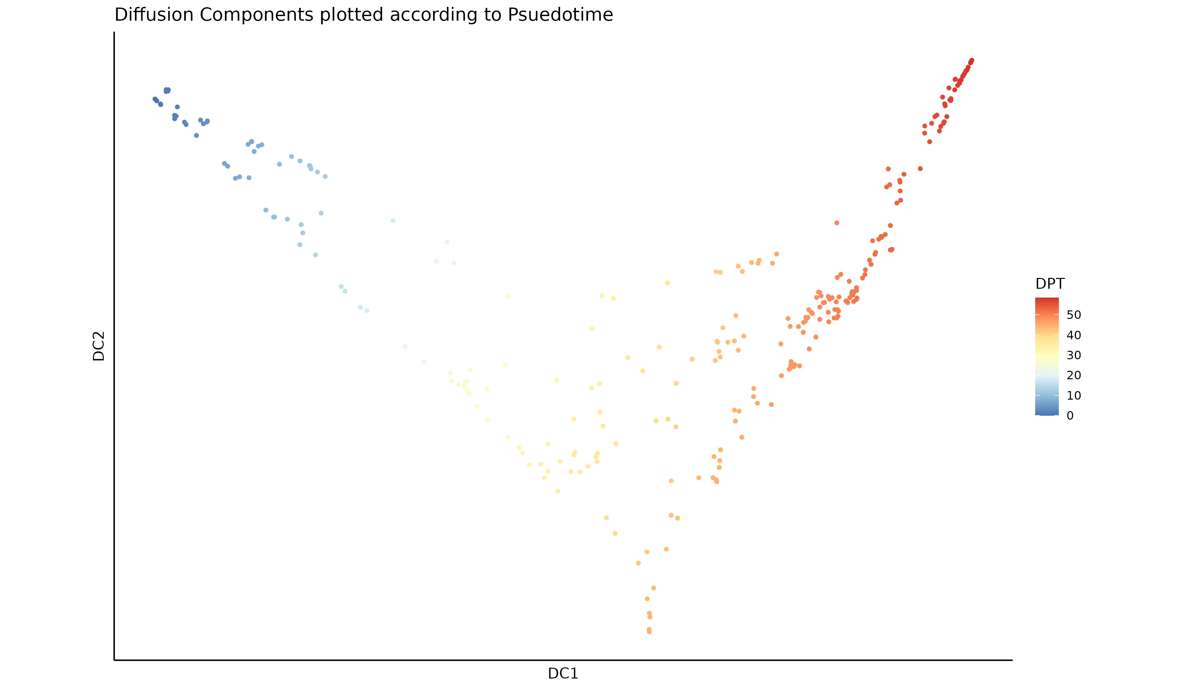
Psuedotime (Engineered Features)

Slide 45
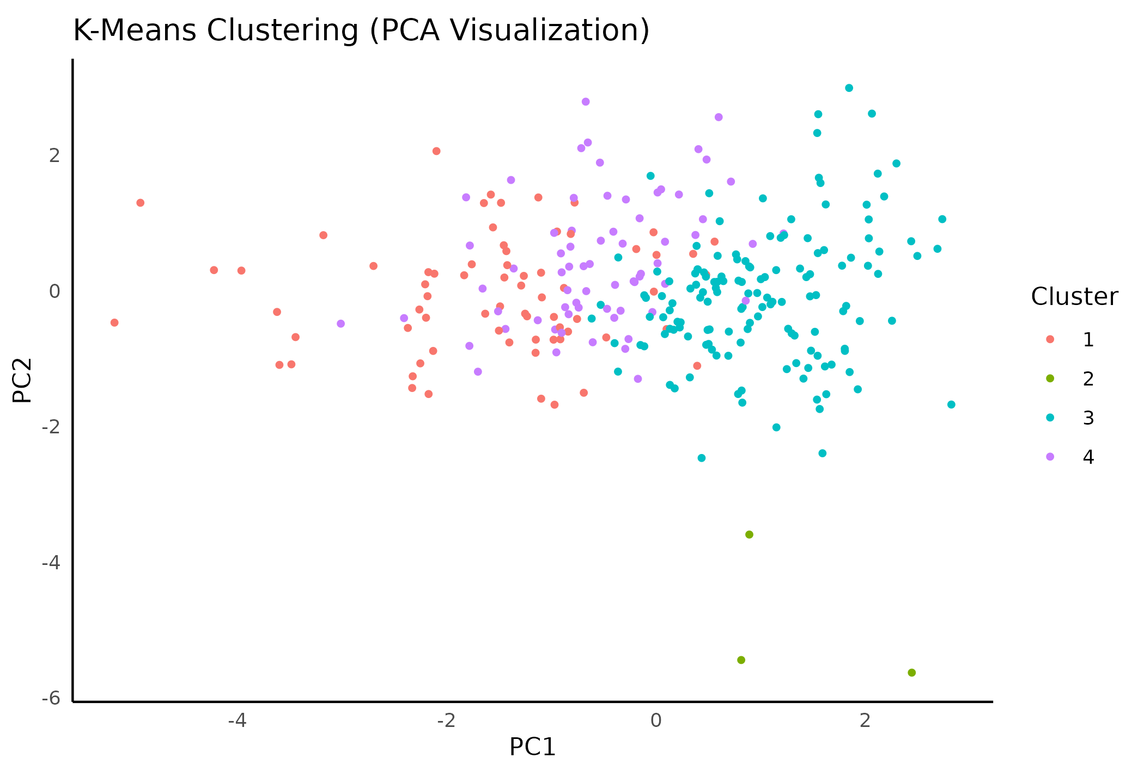
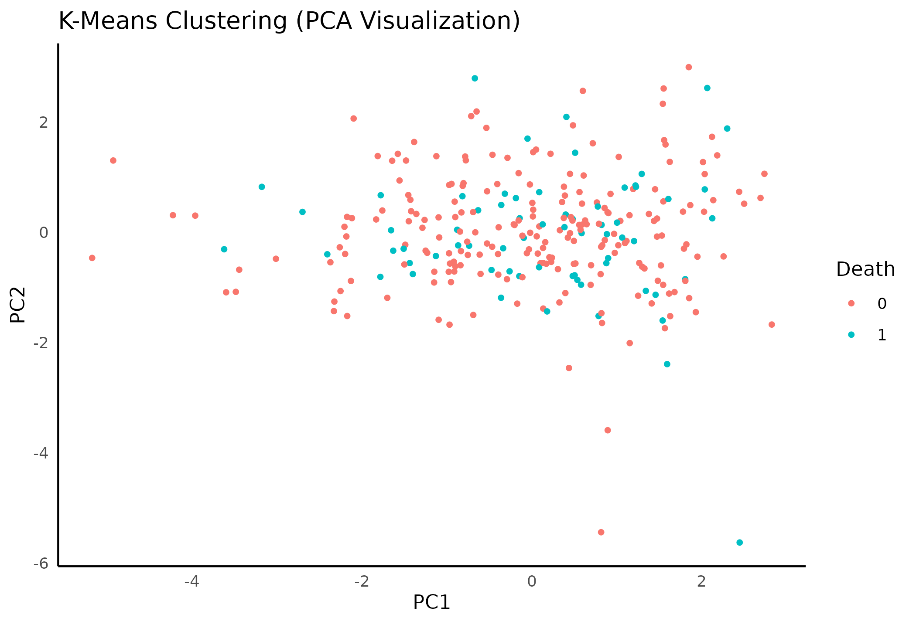
PCA (Engineered Features)

